Slide 1

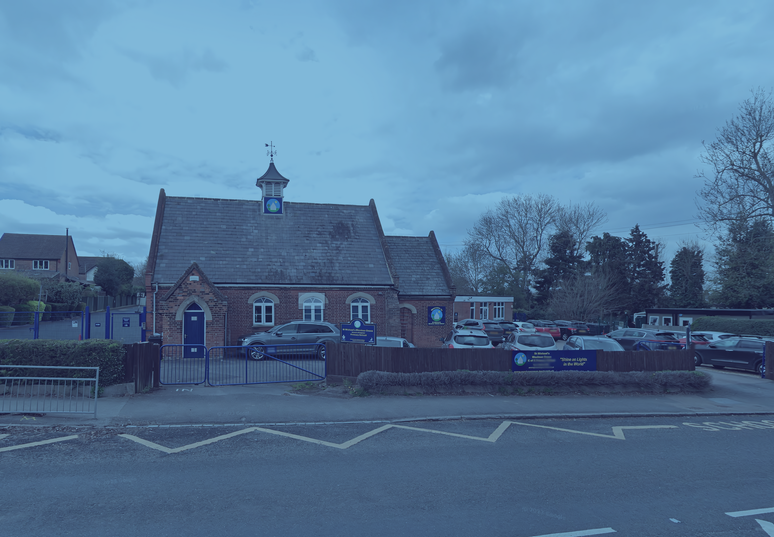
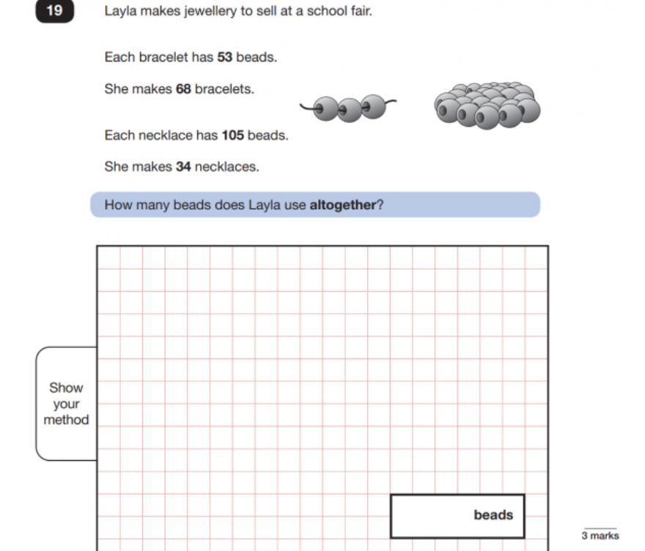
Oak Class
Transition Meeting 2026

Slide 2
Welcome!
Today, I want to welcome you to our classroom, discuss what we do in Year 6 and share our rules, expectations and routines for the year ahead.

Slide 3
The Team
Mrs Pulham
Mrs Fincham
Mrs Martin
Mrs Castle

Slide 4
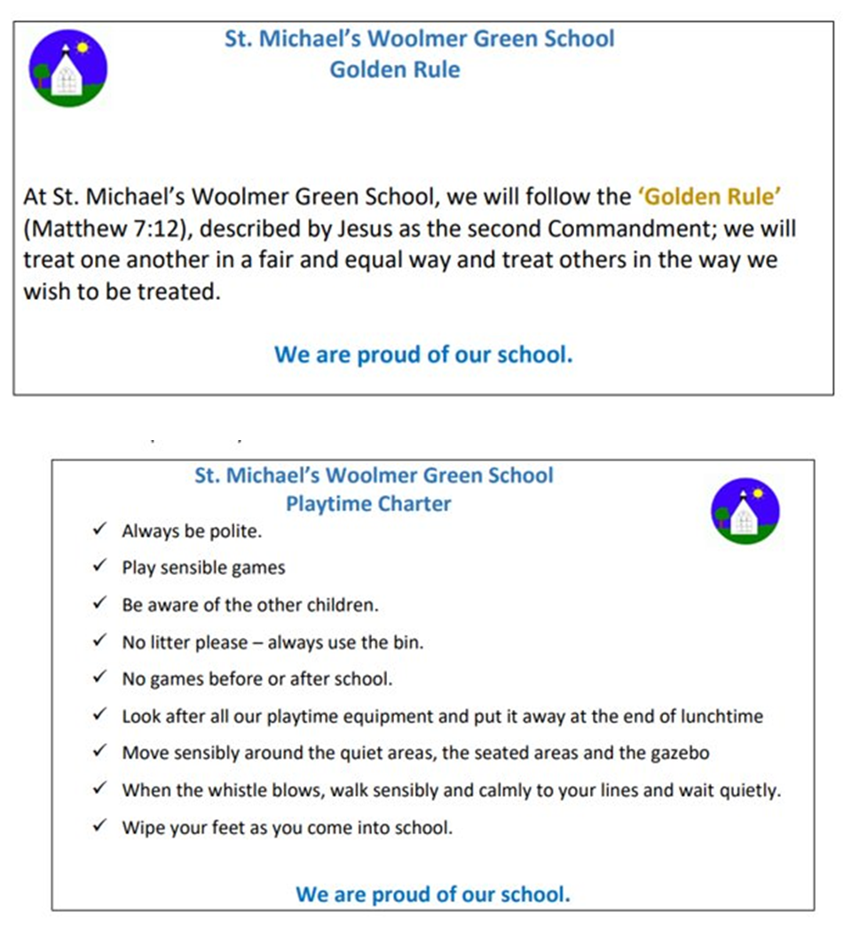
Expectations

Slide 5
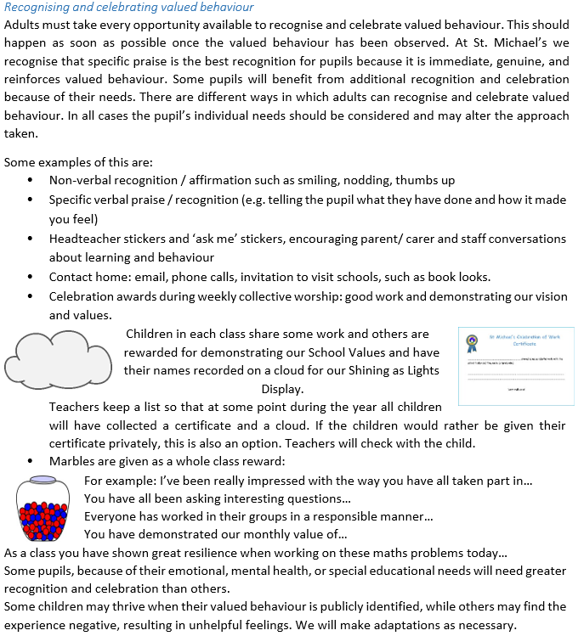

Slide 6
Things to look forward to:
Buddies ☺
Responsiblities
Sports Leaders
Leading assemblies
Crucial Crew
End of year performance
PGL
SAT’s!

Slide 7
Uniform
Names should be in all uniform to avoid lost property
School colour hair bands​
No jewellery (crosses must be removed for PE)​
Plain gold or silver stud earrings – (removed from home on PE days)​
No nail varnish
Black shoes with no markings
Shirts must be tucked in while in class.
PE:
•Children to come into school in their PE kits on a Monday and Thursday this half term.
•Please ensure that it is the correct uniform – blue joggers, navy shorts or skirt (no cycling shorts), navy blue t-shirt, school hoody or jumper – royal blue.

Slide 8
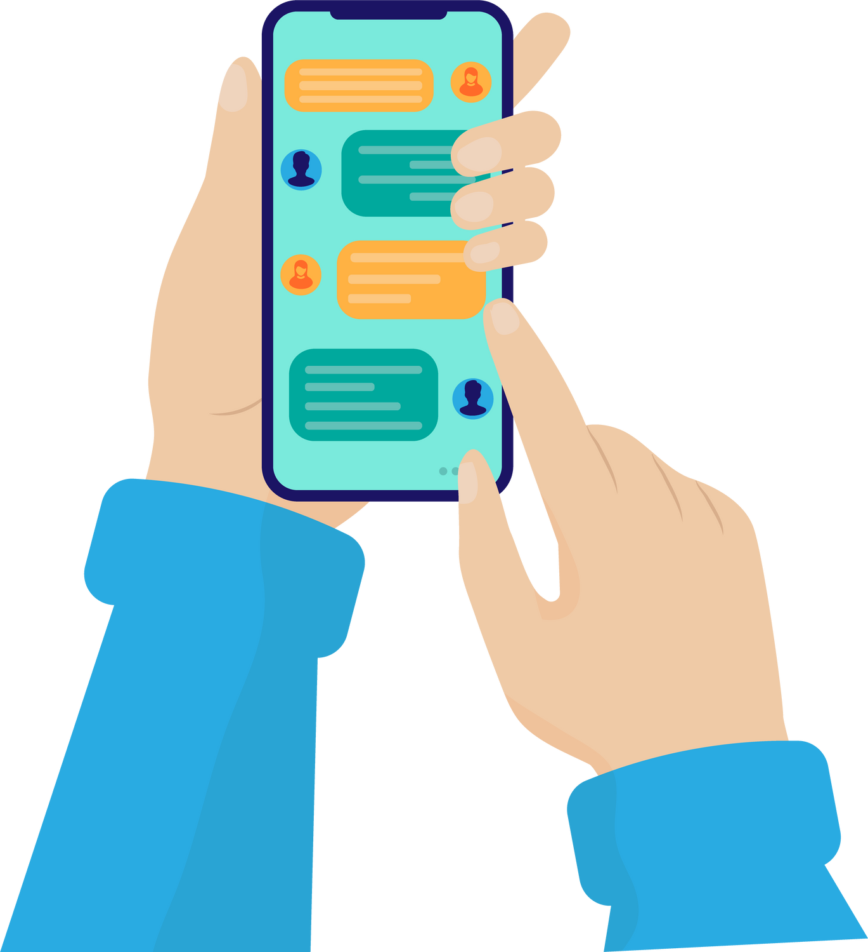
Phones and social media
As children begin walking home from school, we understand that many will bring in a mobile phone. We continue to use the phone box that stays in reception.
We also ask that no phones are used by children or adults on site.
Keep an eye on phone usage and WhatsApp groups/ online gaming – issues have arisen previously

Slide 9
Daily Routine
•8.35am – Gate is open
•8.40am – Classroom Doors are opened – morning work
•8.45am – Start of the school day, gate is locked
•Any late arrivals will have to go via the office

Slide 10
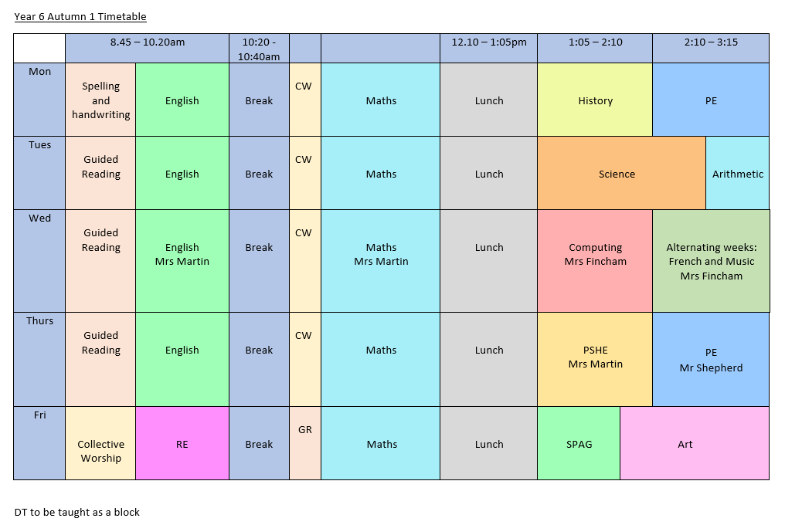
Daily Timetable

Slide 11
What my child needs to succeed?
We do not do homework or spelling tests in Year 6. White Rose books can support at home
After Christmas, you will be able to purchase SAT’s revision books to complete at home.
We do expect ALL children to read at home daily, with an adult or at least twice a week.
If your child is still on a book band, we will also expect them to be making continuous progress across the year.

Slide 12
How can you support your child?
  Read with your child (this has a massive impact!)
  Look at the materials we share on the website.
  Discuss the spellings we upload to the website
  Engage with your child about their learning.

Slide 13
Class Website
Our class website is updated with photos and materials from learning.
Termly overviews, spellings and support materials will be available once the website is up and running.
Alerts will be posted on Classlist.

Slide 14
Things from home
If your child does win an award or trophy, we are happy to celebrate that.
Your child is welcome to bring erasable pens etc from home, but no other stationery, please. All stationery is supplied by us.
Snacks and Water: Bring in water bottles (only water), and if they would like a snack during break, fruit only, please​.
Make sure your permissions are updated with the office.

Slide 15
Follow up
If you have small concerns or worries, the best thing to do is to speak to me directly via the playground.
Other concerns should go via the school emails (admin@woolmergreen.herts.sch.uk) or we can arrange a meeting.
Any questions?

