Slide 1
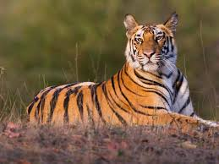
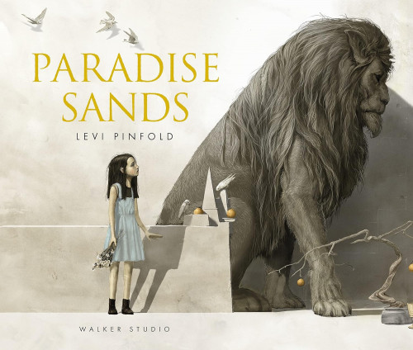

English
Writing
To use a range of verbs, nouns, prepositions and adjectives
To extend sentences by using a wider range of conjunctions
To use different sentence structures, for effect
Punctuate direct speech
To use a range of adverbs and adverbial phrases to add information to a sentence
To edit and improve grammar and content
Reading
To infer from details stated and implied
To retrieve information from a text using skimming and scanning skills
Key texts include: Paradise Sands, Can we save the tiger?
Maths
To use and understand ratio and proportion
To complete scale drawings
To understand substitution and formulae in algebra
To understand place value within 1
To multiply fractions by 10,100 and 1000
To divide fractions by 10, 100 and 1000
To find percentages of amounts
To understand equivalent fractions, decimals and percentages
To find area and perimeter of shapes
To find volume
Science
Light
Understand and explain how light travels
Explore how to change the size of a shadow
Recording data and results of increasing complexity
Living things & their habitats
Give reasons for classifying plants and animals based on specific characteristics
Describe how living things are classified into broad groups
Planning different types of scientific enquiries
Oak Class
Spring Term
Religious Education
Christianity
What matters most to Humanists and Christians?
To identify Christian and Humanist beliefs
To compare what it’s like to be a Humanist and a Christian
To make clear connections between Christian and Humanist ideas about being good and how people live.
Salvation
To share the key piece of evidence, a series of witness statements in Luke’s Gospel.
To Understand why Christians believe in the resurrection.
To understand why Easter Sunday is seen by Christians as a day of hope.
Art
Painting and Mixed Art – Artist Study
Create expressively in their own personal style and in response to their choice of stimulus, showing the ability to develop artwork independently.
Combine materials and techniques appropriate to fit with ideas.
Work in a sustained way over several sessions to complete a piece, including working collaboratively on a larger scale and incorporating the formal elements of art.
Geography
Topic: Why does Population change?
To use an atlas to name and locate countries
To understand population maps and create a bar chart from this information
To understand reasons why population may change
Define migration, describing push and pull factors
Suggest an action they can take to fight climate change
Design Technology
Tapestries
Design an innovative, functional product.
Use a wider range of tools and equipment to perform practical tasks
Evaluate ideas and products against own design and consider the views of others to improve their work.
French
Le week-end
Ask/tell the time in French.
Learn how to say what they do at the weekend
Learn to integrate connectives into their work.
Present an account of what they do and at what time at the weekend
Music
Exploring and using skills using the Glockenspiel
Play and memorise a tune
Improvise and compose
Play instrumental parts of a song by ear
Computing
CAD
To identify the use of CAD (design, make and evaluate)
Graphing
To create a range of graphs using graphing software (bar, line, pie)
Spreadsheets
To use spreadsheets to record, calculate and gathering information
PSHE​
Dreams & Goals & Healthy Me​
​
Setting realistic goals​
Identifying world issues and how to make things better​
Know what others like about me and being able to give compliments to others​
Taking responsibility for health and wellbeing including the effects of drugs​
Know about gangs & understand risks
P.E
Tennis
Football

