Slide 1




Collective Worship
School vision
‘Shine as Lights in the World’
Matthew 5.16
Thinking Me
‘Blessed is the man who perseveres under trial, because when he has stood the test, he will receive the crown of life.’
James 1:12
Golden Rule
‘We will treat one another in a fair and equal way and treat others in the way we wish to be treated’
Matthew 7.12

Slide 2
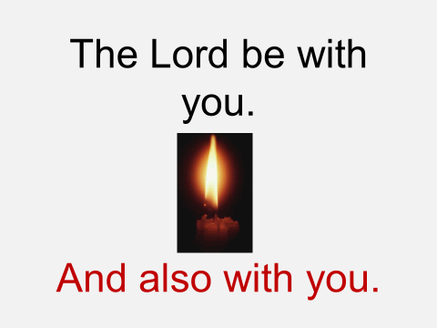

Slide 3

Children’s Mental Health Week 1-7 February 2021
Assembly slides for primary-age children

Slide 4
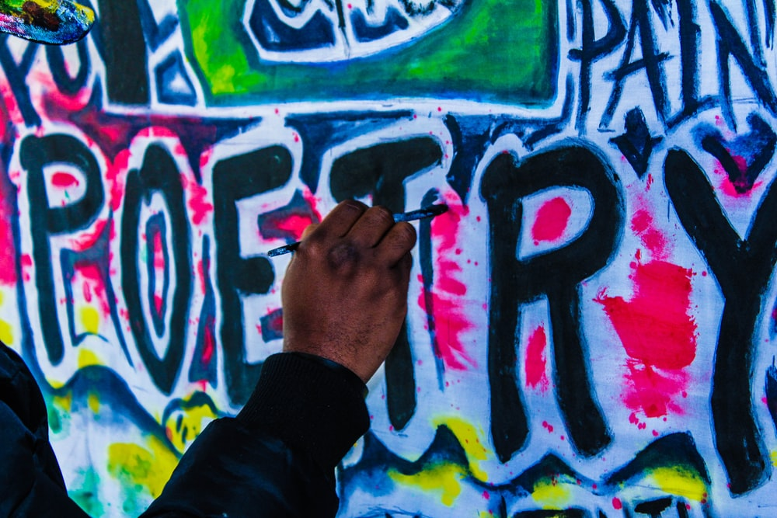
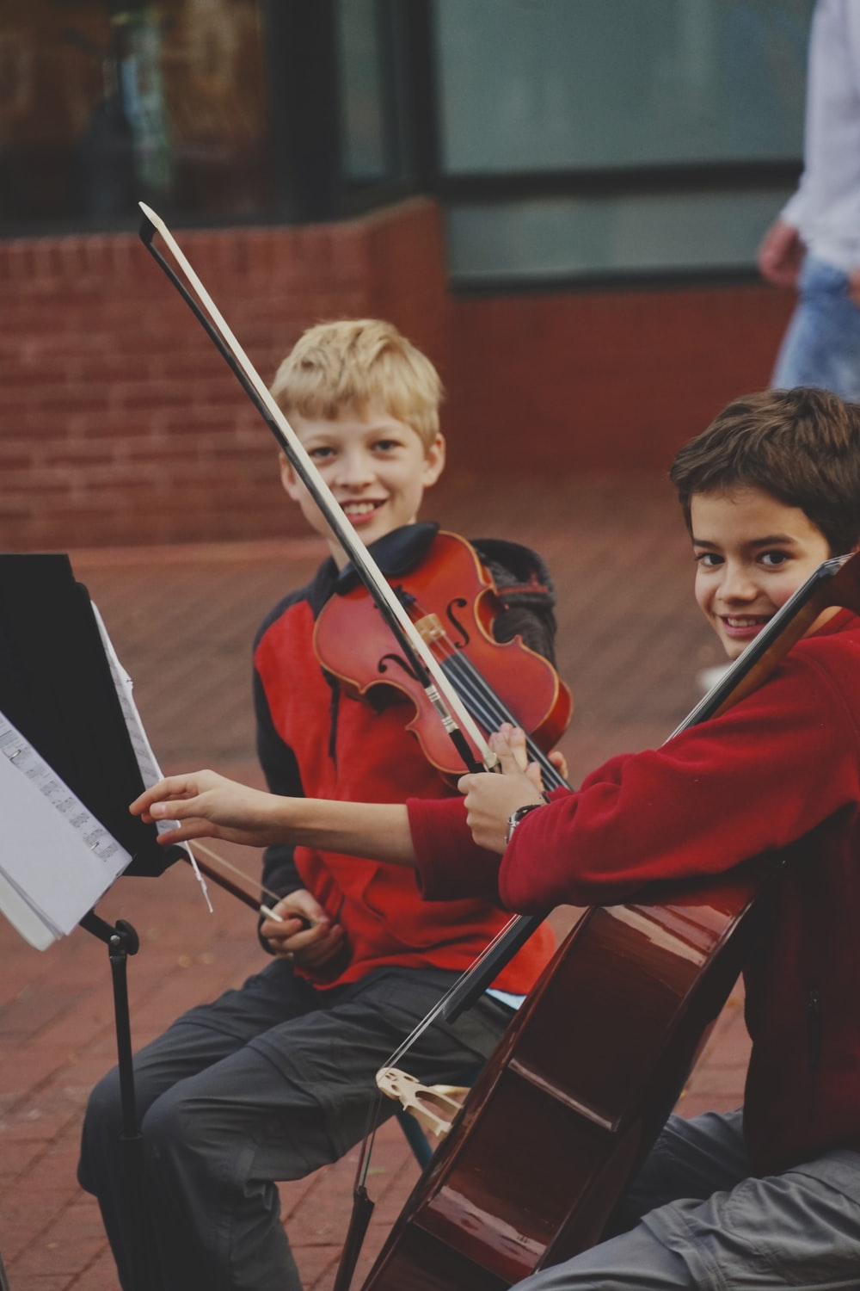

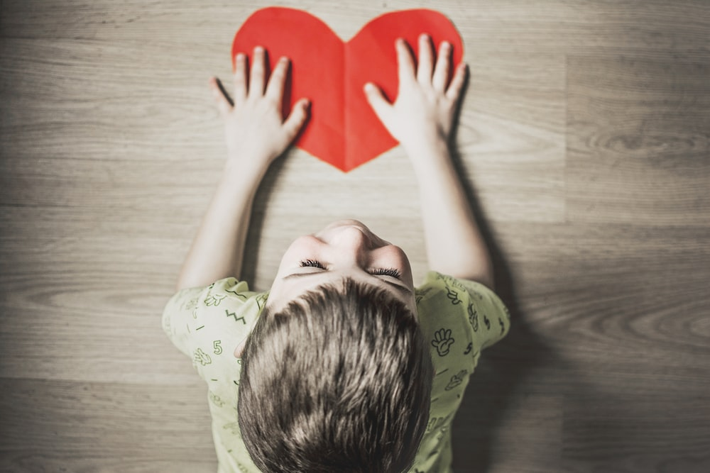

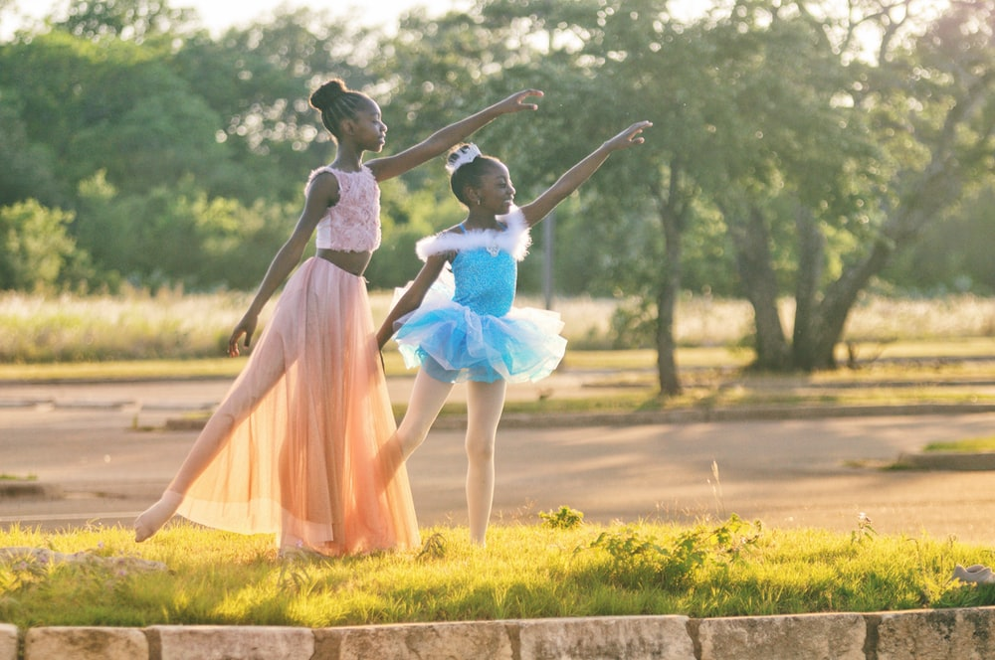
Slide 2

Slide 5

Slide 3

Slide 6

Slide 4

Slide 7

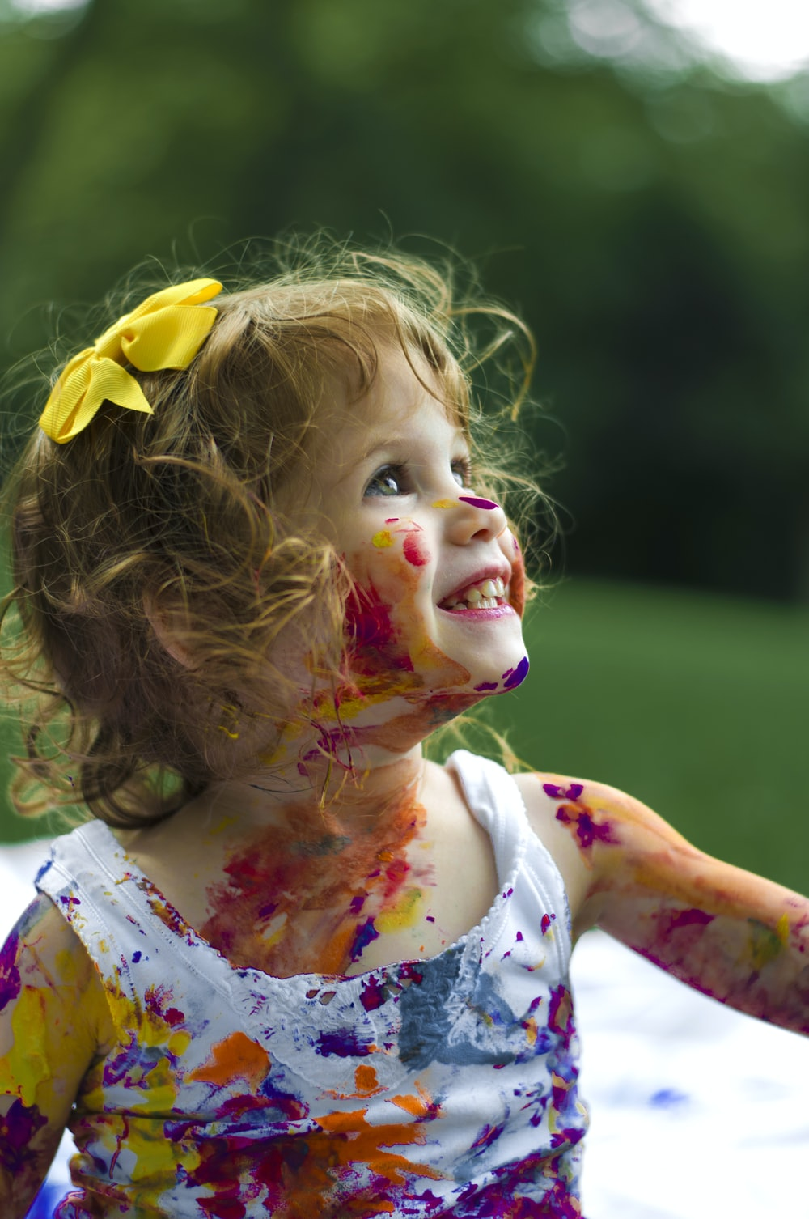
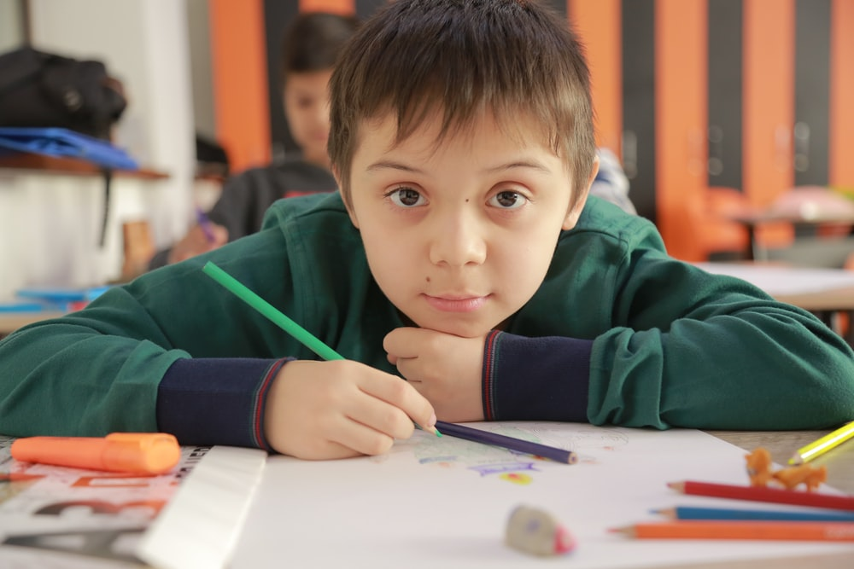
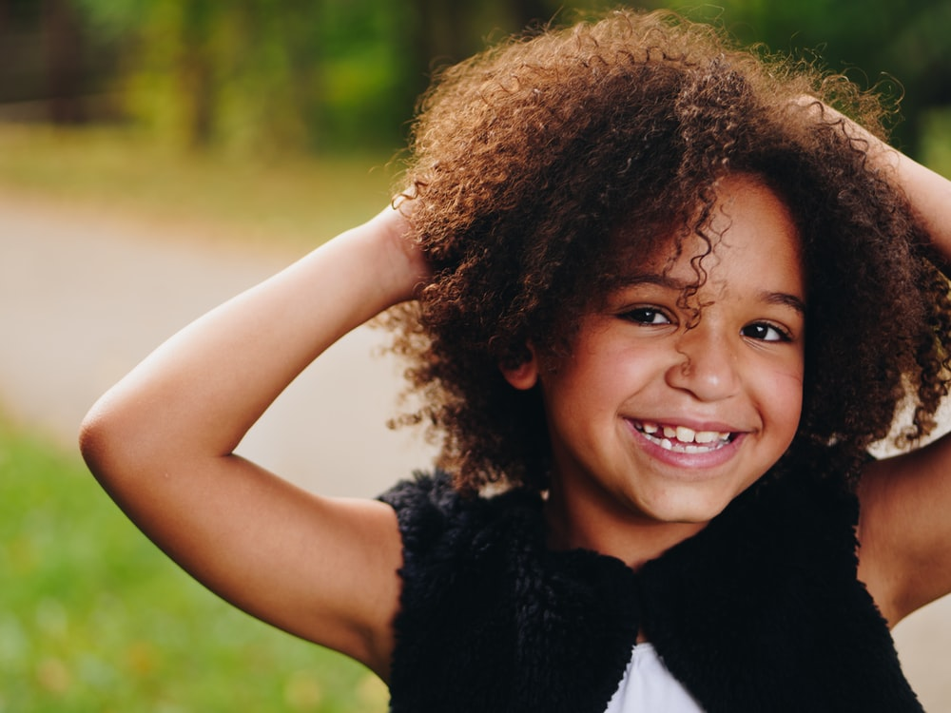
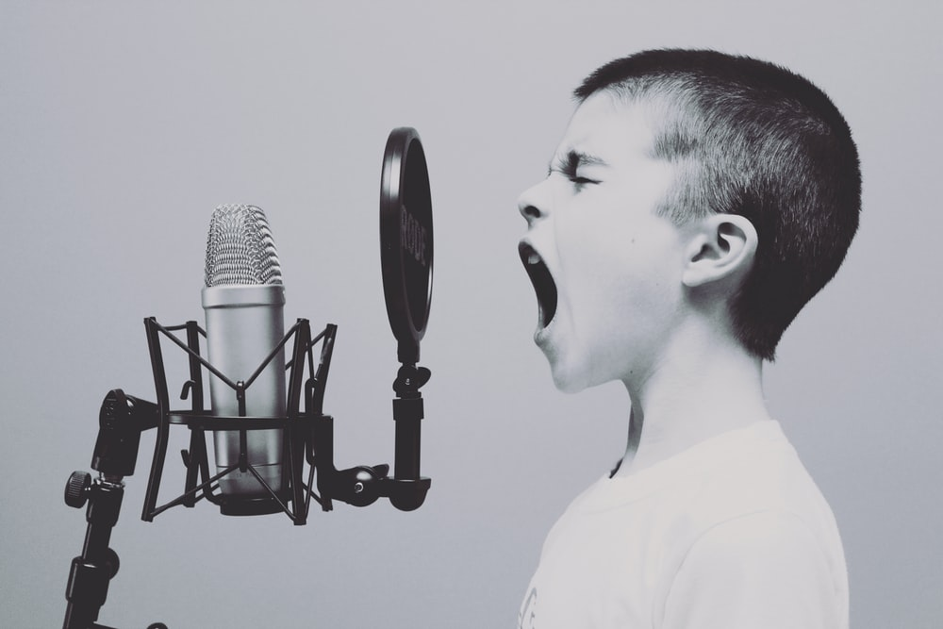
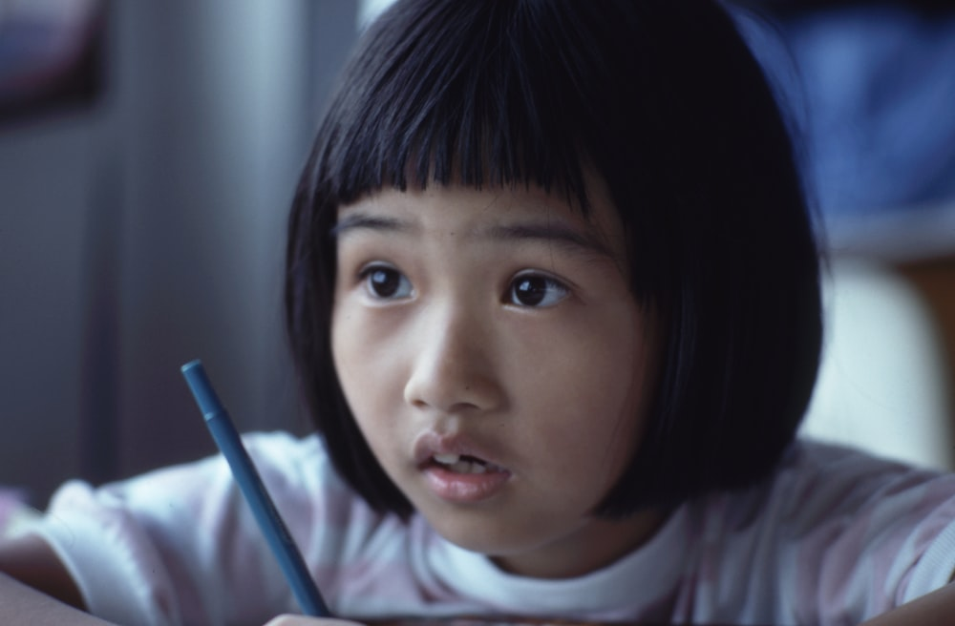
Slide 5

Slide 8

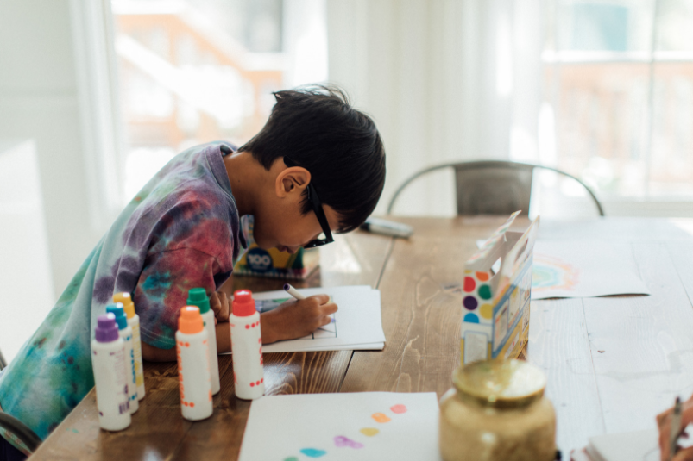
Slide 6
Remember, when we express ourselves we don’t have to be a great artist or a wonderful dancer.
It’s not about being the very best at something or putting on a performance.
Let’s encourage each other to find lots of different ways to get creative and express ourselves.

Slide 9



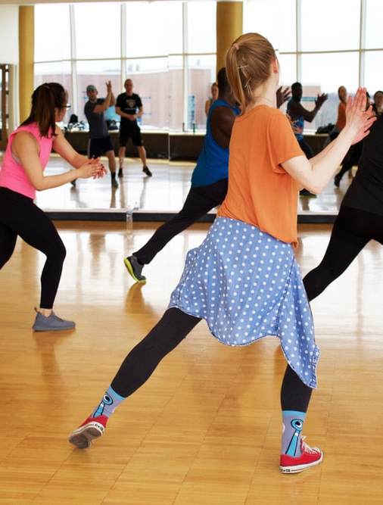
Slide 7
You might like to try the Squiggle Game

Slide 10
REFLECTION
What will you try this week to make you feel good? How will you express yourself?
We will now watch this animated version of the ‘Beautiful Oops’
Challenge yourself:Don’t forget the daily challenge I have set you this week:
Login to imoves.com
Class ID: 59896 Secret password: Fine
There are 5 activities to do, one each day. Please share any thoughts or photos with us of you expressing yourself.

Slide 11

All images in this presentation are royalty free from unsplash.com and canva.com
Beautiful Oops is by Barney Saltzberg, published by Workman Publishing
Remember to watch the assembly created in partnership with BAFTA kids and Oak Academy on the theme of Express Yourself. It is live at 9am on Monday 1st February, but if you can’t watch it live, make sure you watch it later.

Slide 12

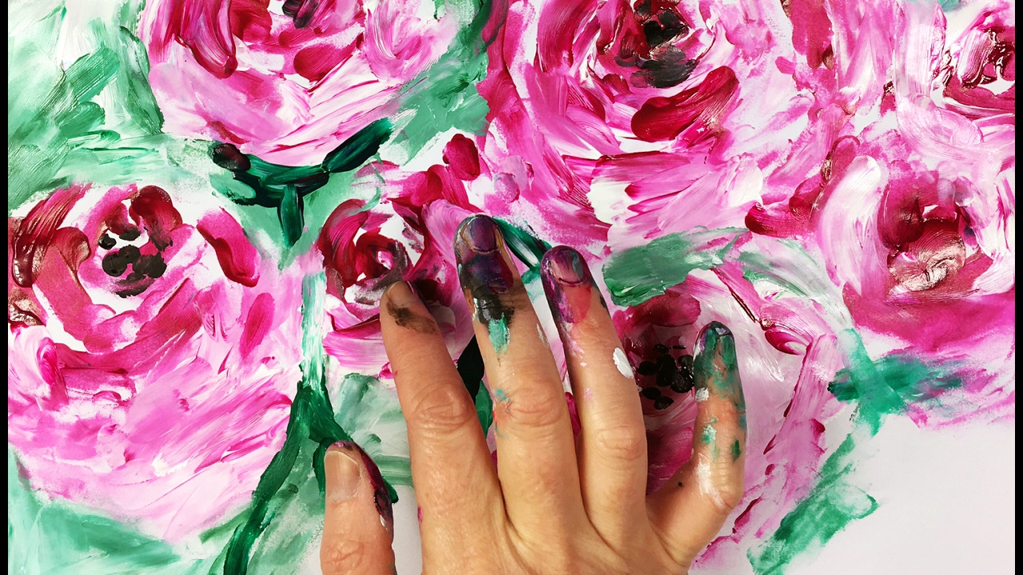
Let us pray…
Dear God
Please help us to express ourselves creatively this week, so that we feel good,
happy, relaxed and excited. We can all find creativity in many different ways and it is a good way of caring for our mental health. We are all going through a very challenging time at the moment, so please help us to care for both our physical and mental health.
Amen

Slide 13

Go in peace to love and serve the Lord.
In the name of Christ. Amen.

