Slide 1
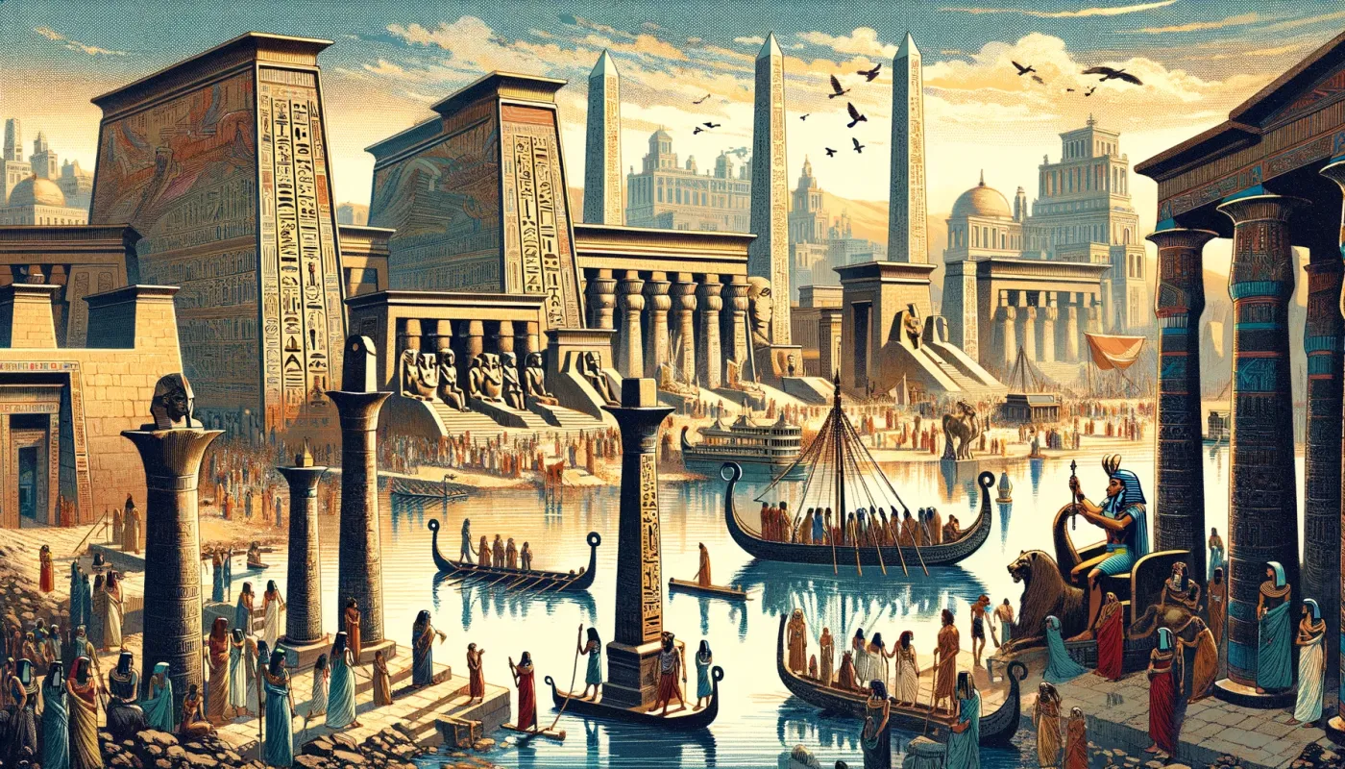
English
To use fronted adverbials
To use verbs and adverbs for detail.
To use paragraphs
To use the correct tense when writing
To go back and edit to improve work.
To use a range of punctuation
The books for this term are:
Flotsam by David Wiesner
Our Tower by Joseph Coelho
The Day I swapped my Dad for two Goldfish by Neil Gaiman
Science
Identifies that animals, including humans need the right types and amounts of nutrition and have skeletons and muscles for support, protection and movement
To recognise that they need light in order to see things and that dark is the absence of light.
To know that light is reflected from surfaces.
Maths
Can solve problems involving the adding and subtracting fractions
Can identify horizontal and vertical lines and pairs of perpendicular and parallel lines
Can tell and write the time from a digital (AM/PM) or analogue clock.
Add and subtract amounts of money to give change, using both £ and p in practical contexts.
Interpret and present data using bar charts, pictograms and tables
Solve one-step and two-step questions using information presented
Ancient Egypt
Redwood Year 3
Summer Term
Religious Education
Identify some beliefs about God in Islam, expressed in Sura 1 of the Qur’an
Identify how Eid-ul-Fitr is celebrated
Make links between different religions, which all celebrate the triumph of goodness over evil
Make clear links between the calling of the first disciples and how Christians today try to follow Jesus and be ‘fishers of people’
Make simple links between Bible texts and the concept of ‘Gospel’
Make links between the Bible stories studied and the importance of love, and life in the world today, expressing some ideas of their own clearly
History
To Identify Ancient Egypt’s location and its key geographical features.
Explain why the River Nile was important to ancient Egyptians.
Explain the significance of the Rosetta Stone.
Explain the importance of gods and goddesses to people in ancient Egypt.
Geography
Describe what lines of latitude and longitude are, giving an example.
Understand that the Northern and Southern Hemispheres experience seasons at different times.
Define what climate zones are.
Understand Antarctica has a polar climate made up of ice sheets, snow and mountains.
French
To recall and spell five different verbs in the foreign language.
To read and spell all the key vocabulary related to the story of Petit Chaperon rouge (Little Red Riding Hood)
Computing
To explore simulations
To analyse and evaluate a simulation
To create a PowerPoint presentation using learnt skills (media, animations and timings)
Music
To play instrumental parts with the Disco song, Bringing Us together
Design and Technology
To explain the purpose of packaging
To understand 3D shapes come from nets
To design, makes and evaluate a package fit for purpose
Art
To make a structure that holds its 3D shape.
Explain in simple terms the difference between 2D and 3D art.
P.E.
Handball
Athletics
Cricket
OAA
Yoga
PSHE
Relationships
Changing me

