Slide 1
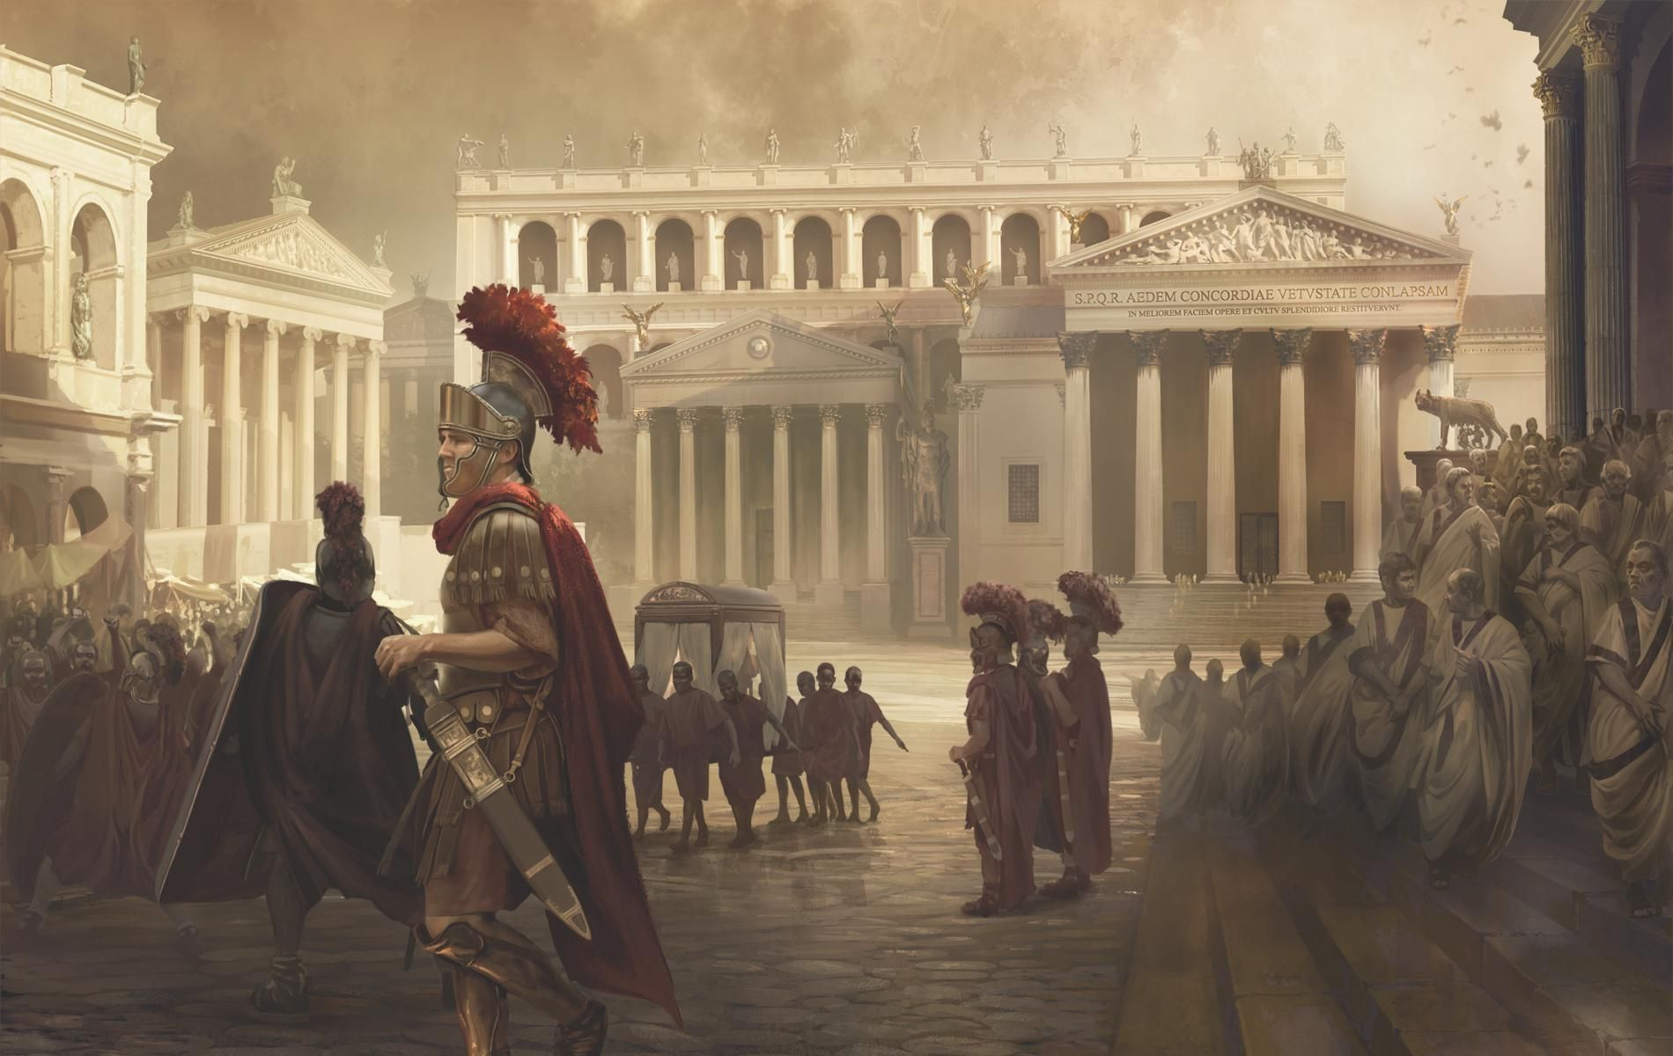
English
Writing
To write sentences correctly using a capital letter and with appropriate punctuation
To show awareness of verbs, nouns, prepositions and adjectives .
To extend sentences by using a wider range of conjunctions.
To start a new line for dialogue for a new speaker.
Begin to use inverted commas to punctuate direct speech.
To use a range of adverbs and adverbial phrases to add information to a sentence.
To use the diagonal and horizontal strokes that are needed to join letters.
To change sentence structures to interest the reader
Reading
Can retrieve and record information from a text
Can infer meaning from a characters actions
Key texts include: Escape from Pompeii,The Pied Piper of Hamlin, Small in the city.
Maths
To measure in mm and cm.
To understand equivalent lengths.
To work out perimeter of shapes.
To compare and order fractions.
To place fractions on a number line.
To measure mass in g and kg.
To understand equivalent mass.
To compare capacity and volume.
To continue to increase our pace in recall of our 2, 3, 4, 8, 10 and 11 times tables
History
The Romans
Explain the meaning of the words ’empire’, ‘invasion’ and ‘settlement’.
Analyse the different reasons for the Roman invasion of Britain.
Explain how the Celts responded to the Roman invasion.
Explain how the Roman army’s structure, discipline and equipment made it so successful.
The Romans
REDWOOD - Year 3
Spring TERM
Science
Scientific Enqury
Set up simple practical enquiries, comparative and fair tests
Make systematic and careful observations and, where appropriate, take accurate measurements using standard units
Plants
Identify and describe the functions of different parts of flowering plants
Explore the requirements of plants for life and growth
Religious Education
Sikhism
To understand the key beliefs of Sikhism .
To explore the teachings of the ten Gurus.
To know what Gurdwaras are, what their features are and compare them with a Church.
Salvation
To understand the events of Palm Sunday, Good Friday and Easter Sunday .
To write diary entries to show our knowledge.
To create a triptych reflecting Holy Week.
Geography
Topic: Why do people live near volcanoes.
Describe a tectonic plate and know that mountains occur along plate boundaries.
Name three ways in which volcanoes can be classified.
Explain a mix of negative and positive consequences of living near a volcano.
Art
Growing Artists
Use simple shapes to form the basis of a detailed drawing.
Use shading to demonstrate a sense of light and dark in their work.
To blend tones smoothly.
Design Technology
Mini Green House
To explore greenhouses.
To investigate what materials to use.
To evaluate a finished product.
French
Recognise, recall and remember the 4 seasons in French.
Say which season is their favourite in French and attempt to say why using the conjunctions ‘et’ and ‘car’.
Music
Ukulele
To play notes on the beat.
To be intime with music.
Computing
Spreadsheets
Graphing
Email
PSHE
Thinking Me
Concentration
Problem-solving
Curiosity
Decision-making
P.E
Basketball
Gymnastics
Tennis
Dance

