Slide 1

SATS Information Meeting for Parents 2024
The KS2 SATs will take place between Monday 13th May and Thursday 16th May 2024.

Slide 2

AIMS
What are the SATs like?
What tests are administered?
How we can support/prepare the children?
How they are marked?
What you can do to support your child.

Slide 3
The SATs Tests 2024
The children will complete tests in the following areas:
Monday: SPAG test – 45 minutes: Spelling test – 20 minutes
Tuesday: Reading test – 60 minutes
Wednesday: Maths paper 1 (Arithmetic) 30 minutes
Maths paper 2 (Reasoning) 40 minutes
Thursday: Maths paper 3 (Reasoning) 40 minutes

Slide 4
Grammar and Punctuation, Spelling Test (GPS)
The grammar, punctuation and spelling test will consist of two parts: a grammar and punctuation paper requiring short answers, lasting 45 minutes, and a spelling test of 20 words, lasting around 15 minutes.
The grammar and punctuation test will include two types of questions:
Selected response, e.g. ‘Identify the adjectives in the sentence below’
Constructed response, e.g. ‘Correct/complete/rewrite the sentence below,’ or, ‘The sentence below has an apostrophe missing. Explain why it needs an apostrophe.’

Slide 5
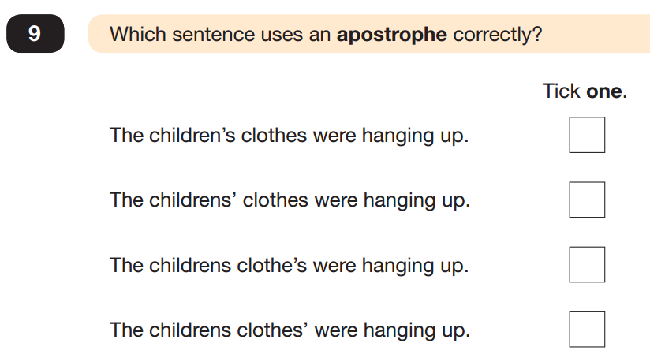
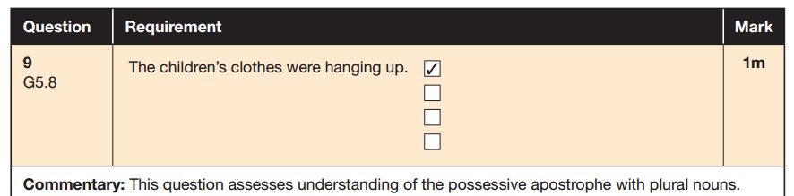

Slide 6
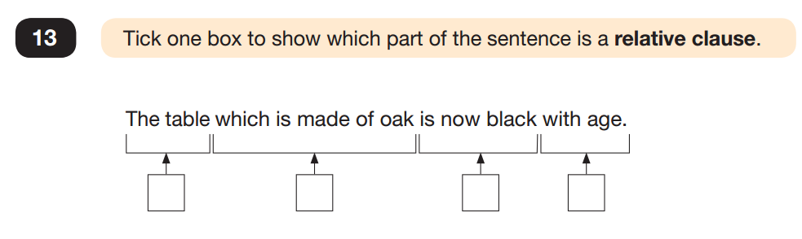
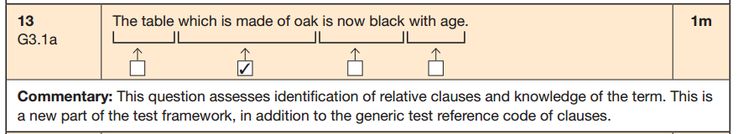

Slide 7
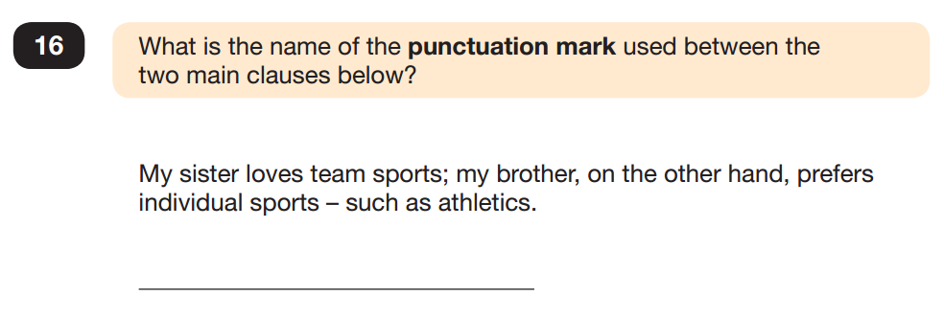
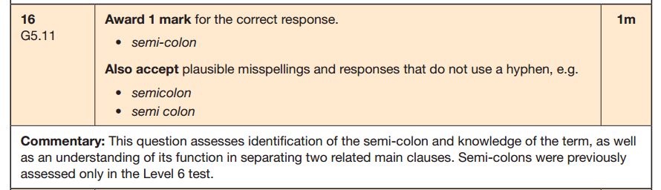

Slide 8
Spelling Test
1)The children were …………….. to go on the ride next.
2) Out of …………………., the children walked along the left hand side of the corridor.
3) Miss Capper struggled with the ………………….. of some of the words in the spelling test!
1)guaranteed
2)convenience
3)pronunciation

Slide 9
Reading Paper
In KS2 English SATs your child will be assessed on a range of reading skills, such as the ability to interpret information and comment on writers' use of language.
The reading test will be a single paper with questions based on three passages of text.
Children will have one hour, including reading time, to complete the test.
Types of questions:
Ranking/ordering, e.g. ‘Number the events below to show the order in which they happen in the story’
Find and copy, e.g. ‘Find and copy one word that suggests what the weather is like in the story’
Short constructed response, e.g. ‘What does the bear eat?’
Open-ended response, e.g. ‘Look at the sentence that begins Once upon a time. How does the writer increase the tension throughout this paragraph? Explain fully, referring to the text in your answer.’

Slide 10
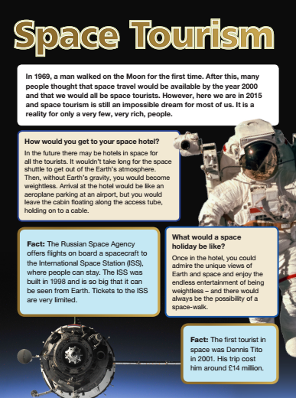
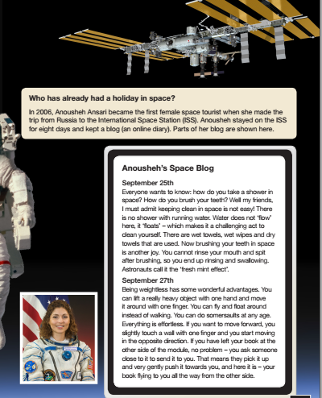

Slide 11
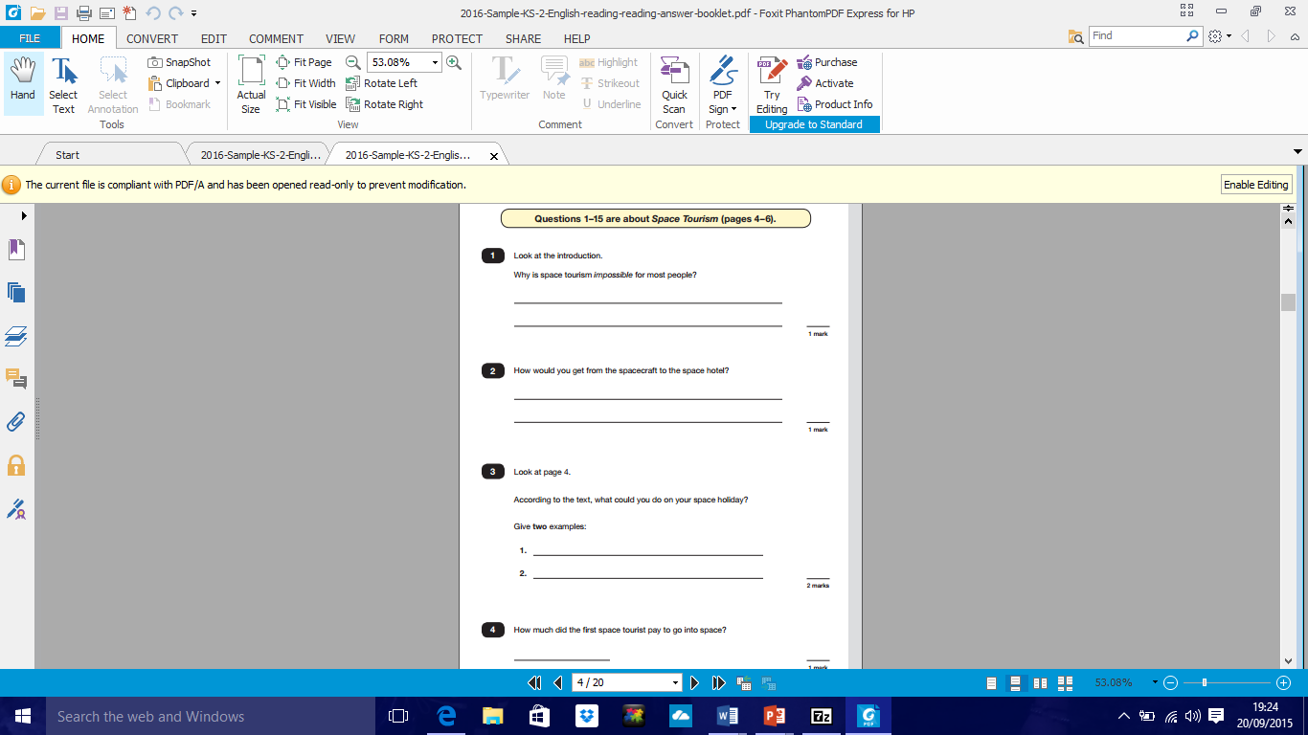
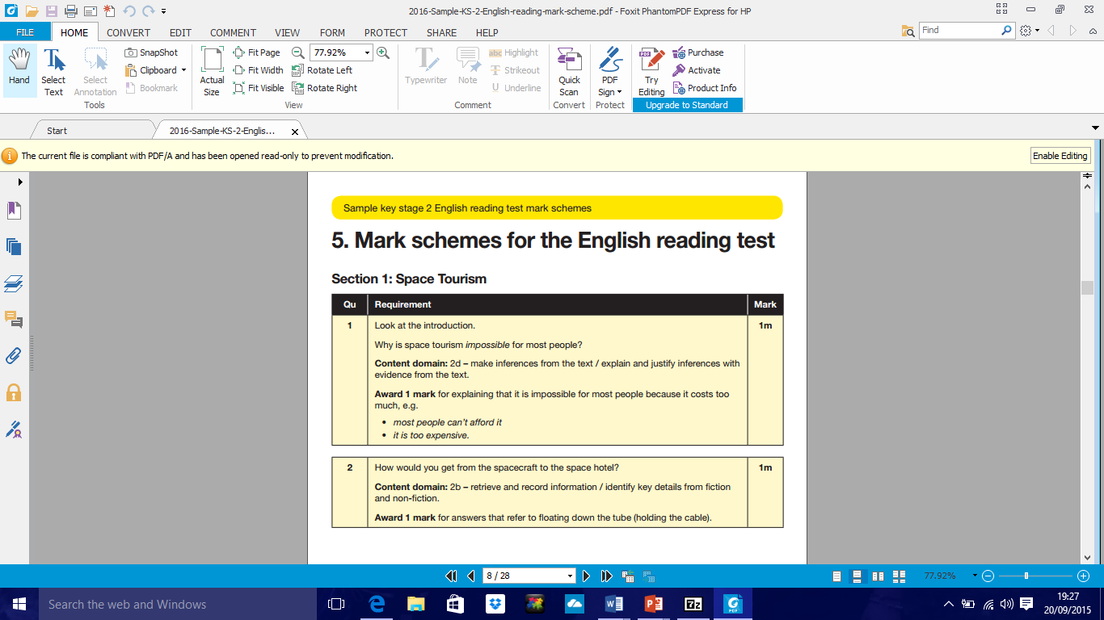

Slide 12
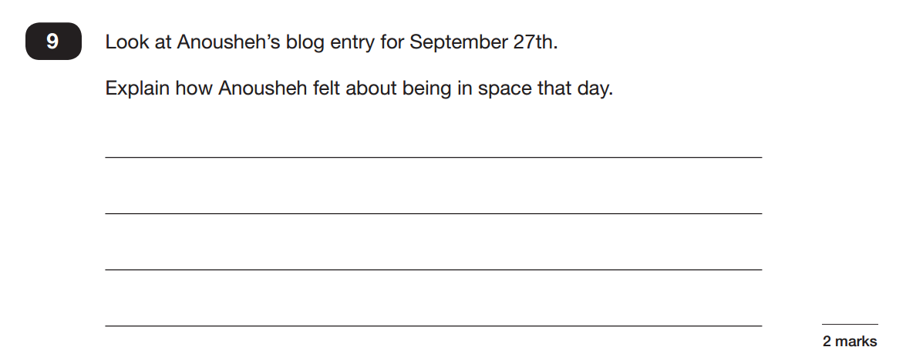
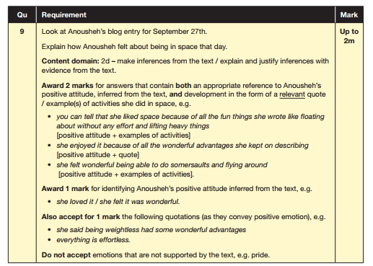

Slide 13
Writing
There is not a Writing SATs paper and children’s writing will be teacher Assessed.
Teacher assessed pieces over the year: using the TAF (Teacher Assessment Framework) Statements
Internal moderation takes place.
External moderation also takes place.
Teacher assessments are reported to County and given to secondary schools.

Slide 14
Maths
In KS2 maths SATs they’ll be tested on a range of core skills, including knowing times tables and using them to divide and multiply, using a protractor to measure angles, calculating the perimeter and area of shapes, solving problems by collecting and using information in tables, graphs and charts, algebra and solving problems involving ratio and proportion.
Children will sit three papers in maths:
Paper 1: arithmetic, 30 minutes
Papers 2 and 3: reasoning, 40 minutes per paper
Paper 1 will consist of fixed response questions, where children have to give the correct answer to calculations. Papers 2 and 3 will involve a number of question types, including:
Constrained questions, e.g. giving the answer to a calculation, drawing a shape or completing a table or chart
Less constrained questions, where children will have to explain their approach for solving a problem

Slide 15
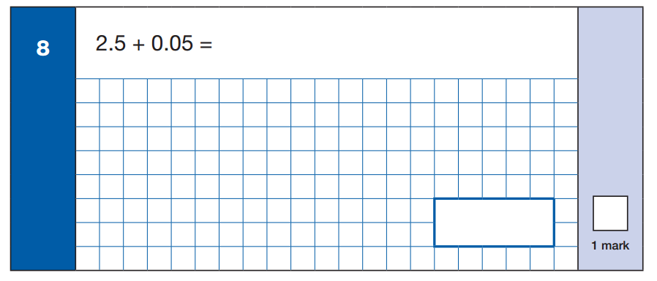
2.55

Slide 16
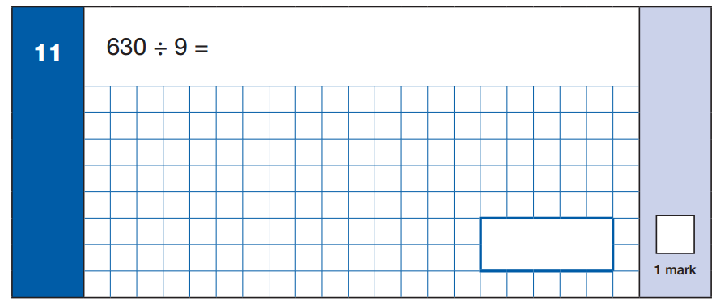
70

Slide 17
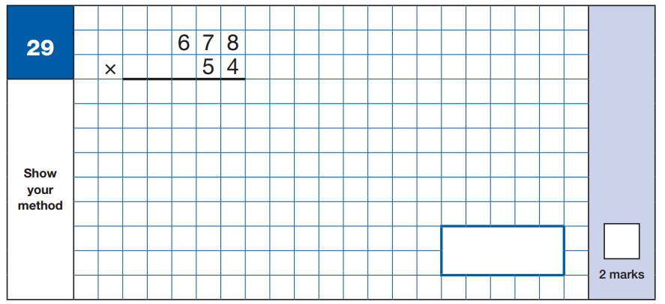
36,612

Slide 18

1/5

Slide 19
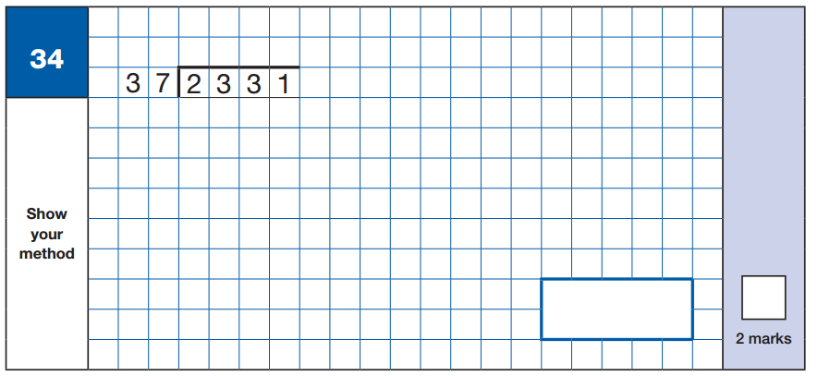
63

Slide 20
Marking the Papers
Children will be given the following…
a raw score (number of raw marks awarded)
a scaled score
confirmation of whether or not they attained the national standard

Slide 21
What to do now… (not panic)
Continue working through the SATs revision guides
Learn all the times tables and division facts up to 12 x 12
Practise written methods of addition, subtraction, multiplication and division
Revise mathematical terminology
Learn different grammatical terminology
Answer questions about reading books
Make revision fun!

Slide 22
What can you do to help?
Try to create a supportive and stress-free environment where children can ask for
help if they need it but are not overworking themselves;
Be encouraging and reassure them that these tests are not the end of the world. All
we ask is that they do their very best;
Make sure the children have time to relax as they will have been working quite intensively at school, so they need time to recharge their batteries;
Encourage any concerns about SATs to be raised with a teacher before the tests take place.
Encourage the children to eat a hearty SATs breakfast;
Ensure any illness is notified to the school as early as possible. If the children are poorly, they
may wish to come in and complete the test and go home afterwards, but it is important that
they attend unless it’s completely necessary to miss the test.

