Slide 1













Slide 2









Ice cream flavour | Topping
Vanilla | Flake
Strawberry | Sprinkles
Chocolate
Mint
How many different combinations are there?
V $+$ F
C $+$ F
S $+$ F
M $+$ F
8 combinations
V $+$ S
C $+$ S
S $+$ S
M $+$ S
Have a think

Slide 3




Ice cream flavour | Topping
Vanilla | Flake
Strawberry | Sprinkles
Chocolate | Nuts
Mint
Ice cream flavour | Topping
Vanilla | Flake
Strawberry | Sprinkles
Chocolate
Mint
How many different combinations are there?
4 ice creams
2 toppings
4 ice creams
3 toppings
V $+$ F
V $+$ S
V $+$ N
8 combinations
12 combinations
4 $×$ 3
What do you notice?
Have a think

Slide 4
How many combinations would there be if there were 6 flavour ice creams and 7 different toppings?
If there are 24 combinations, how many different ice creams and toppings could there be?
How many different combinations would there be if there were different sauces available?
Ice cream flavour | Topping | Sauce
Vanilla | Flake | Blue
Strawberry | Sprinkles | Red
Chocolate

Slide 5



1 ice cream costs the same as 3 ice lollies.
$$=$$
2 ice creams and 5 ice lollies cost £8.80
$$=$$
£8.80
Have a think
Work out the cost of one ice cream.

Slide 6

1 ice cream costs the same as 3 ice lollies.
$$=$$
2 ice creams and 5 ice lollies cost £8.80
$$=$$
£8.80
11$l$ $=$ £8.80
Work out the cost of one ice cream.

Slide 7




11$l$ $=$ £8.80
$l$ $=$ 80p
.
11 | 8 | . | 8 | 0
0
8
0
8
1 ice cream costs the same as 3 ice lollies.
240p or £2.40
$3 l$ $=$ 240p
$$=$$
Work out the cost of one ice cream.

Slide 8

All of the children at Dexter’s school are allowed to choose between an ice cream or an ice lolly for their Sports Day treat.
The ratio of children choosing ice cream to ice lolly is 3 : 2
220 children chose an ice lolly.
How many children chose an ice cream?
How many children are at Dexter’s school?
Have a think

Slide 9
All of the children at Dexter’s school are allowed to choose between an ice cream or an ice lolly for their Sports Day treat.
The ratio of children choosing ice cream to ice lolly is 3 : 2
220 children chose an ice lolly.
How many children chose an ice cream?
330
?
330 children
110
110
110
110
110
220

Slide 10
All of the children at Dexter’s school are allowed to choose between an ice cream or an ice lolly for their Sports Day treat.
The ratio of children choosing ice cream to ice lolly is 3 : 2
220 children chose an ice lolly.
How many children are at Dexter’s school?
330
110
110
110
550 children
550
?
110
110
220

Slide 11
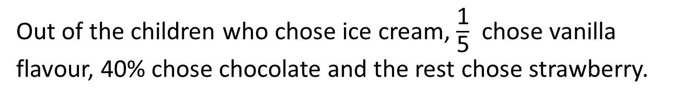
330
110
110
110
550
110
110
Have a think
220
Out of the children who chose ice cream, $\frac{\text{1}}{\text{5}}$ chose vanilla flavour, 40% chose chocolate and the rest chose strawberry.
How many children chose strawberry flavour ice cream?

Slide 12
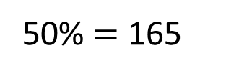


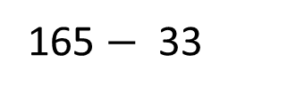
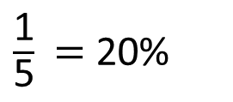

330
$\frac{\text{1}}{\text{5}}$ $=$ 20%
110
110
110
Vanilla and chocolate $=$ 60%
550
Strawberry $=$ 40%
110
110
40% of 330
50% $=$ 165
220
165 $−$ 33
10% $=$ 33
Out of the children who chose ice cream, $\frac{\text{1}}{\text{5}}$ chose vanilla flavour, 40% chose chocolate and the rest chose strawberry.
How many children chose strawberry flavour ice cream?
132

Slide 13
The ratio of children choosing ice cream to ice lolly is 3 : 2
There are 620 children in total. How many children chose an ice lolly?
If 45 children chose ice cream, how many children are there in total?
If 19 more children chose an ice cream than an ice lolly. How many children are there in total?

