Slide 1
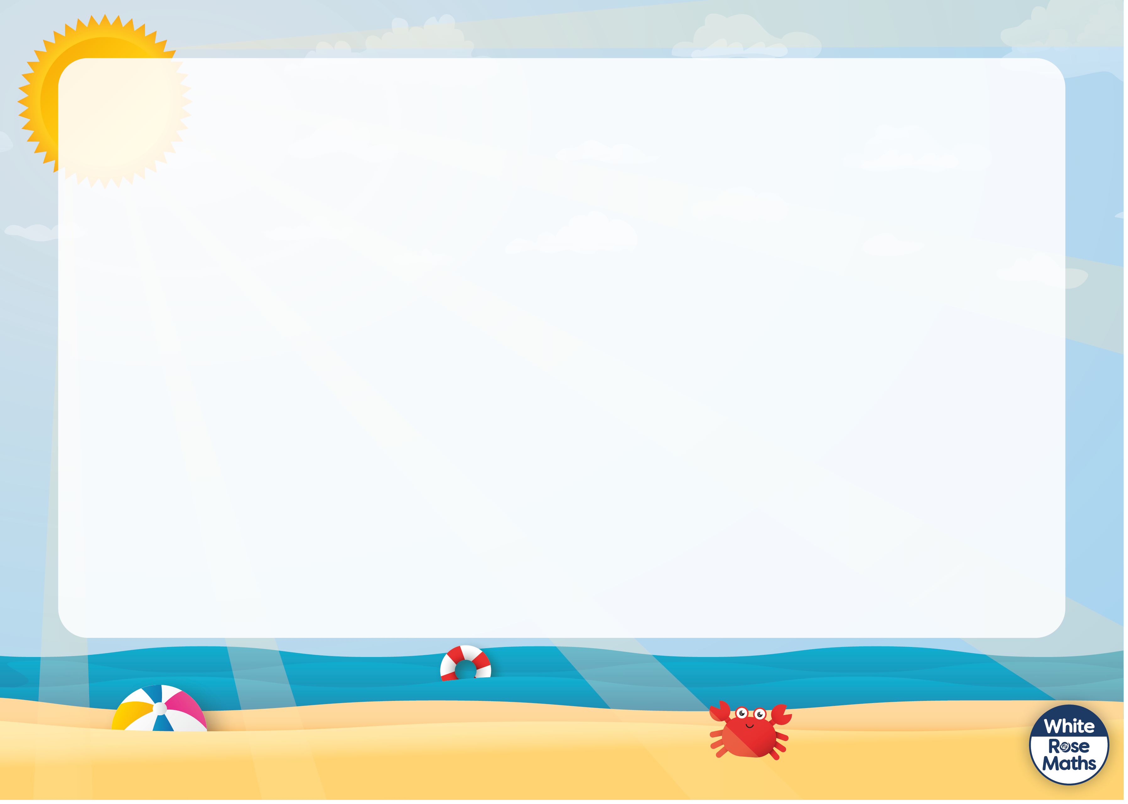




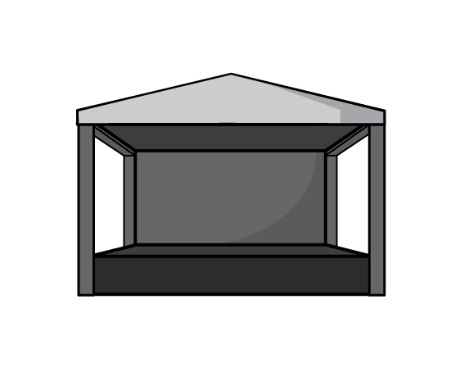



Slide 2


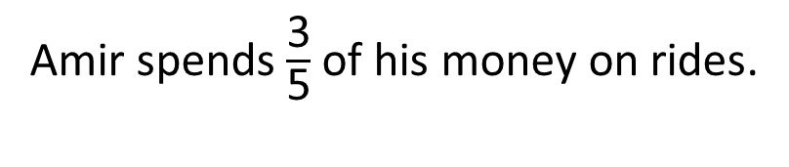
Amir’s dad gives him some money for his trip to the theme park.
Amir spends $\frac{\text{3}}{\text{5}}$ of his money on rides.
He then spends half of the remaining money on lunch.
He has £3 left.
How much money did Amir’s dad give him?
Have a think

Slide 3
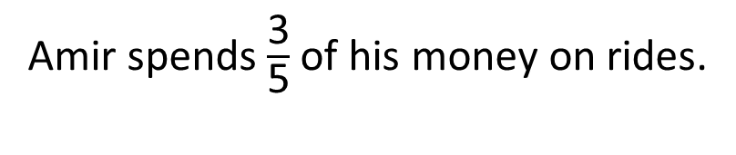
Amir spends $\frac{\text{3}}{\text{5}}$ of his money on rides.
He then spends half of the remaining money on lunch.
He has £3 left.
How much money did Amir’s dad give him?
£15
?
15
3
3
3
3
3
Rides
Lunch

Slide 4

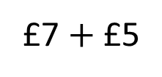
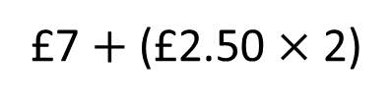
Boat hire
£7 for the first hour.
£2.50 for every half an hour after.
Alex hires a boat for 2 hours.
It will cost Alex £12 to hire a boat for two hours.
How much will it cost Alex?
For 1 hour it costs £7
After that it costs £2.50 for every half hour.
£7 $+$ (£2.50 $×$ 2)
£7 $+$ £5
Have a think

Slide 5

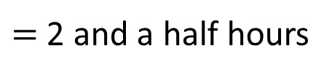
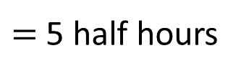
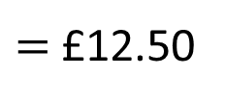
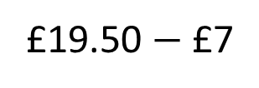
It costs Jack £19.50 to hire a boat.
Boat hire
£7 for the first hour.
£2.50 for every half an hour after.
How long did Jack hire the boat for?
For the first hour it costs £7
£19.50 $−$ £7
$=$ £12.50
After that it costs £2.50 for every half hour.
£12.50
$=$ 5 half hours
$=$ 2 and a half hours
Jack hired the boat for 3 and a half hours.
Have a think

Slide 6

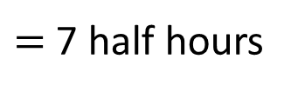
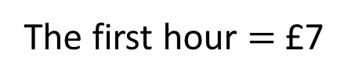

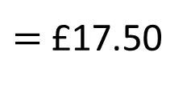

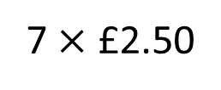
Annie hires a boat at 8:15 am.
Boat hire
£7 for the first hour.
£2.50 for every half an hour after.
She returns the boat at 12:30 pm.
How much will it cost Annie?
£24.50
Annie hires a boat for 4 hours 15 mins.
The first hour $=$ £7
3 hours 15 mins
$+$ 4 hours
$+$ 15 mins
3 hours 30 mins
$=$ 7 half hours
7 $×$ £2.50
$=$ £17.50
Have a think
08:15
12:15
12:30

Slide 7


All the children in Mo’s school voted for where they wanted to go on their end of year trip.
Here are the results.
Theatre
Beach
Theme park
Zoo
$\frac{\text{1}}{\text{4}}$
10%
$\frac{\text{3}}{\text{5}}$
75 children voted for the theatre.
What can you find out?
Have a think

Slide 8


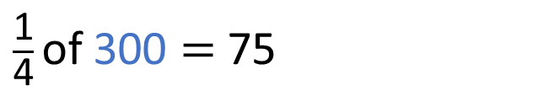
All the children in Mo’s school voted for where they wanted to go on their end of year trip.
Here are the results.
Theatre
Beach
Theme park
Zoo
$\frac{\text{1}}{\text{4}}$
10%
$\frac{\text{3}}{\text{5}}$
75 children voted for the theatre.
$\frac{\text{1}}{\text{4}}$ of 300 $=$ 75
300
75
75
75
75
75

Slide 9
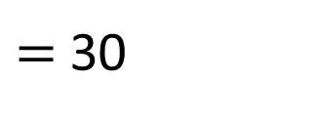
All the children in Mo’s school voted for where they wanted to go on their end of year trip.
Here are the results.
300
Theatre
Beach
Theme park
Zoo
$\frac{\text{1}}{\text{4}}$
10%
$\frac{\text{3}}{\text{5}}$
30 children voted for the beach.
75 children voted for the theatre.
10% of 300
$=$ 30
What can you find out?

Slide 10
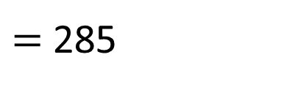
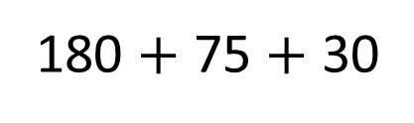
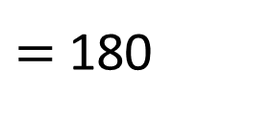
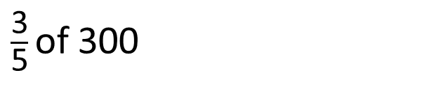
All the children in Mo’s school voted for where they wanted to go on their end of year trip.
Here are the results.
300
Theatre
Beach
Theme park
Zoo
$\frac{\text{1}}{\text{4}}$
10%
$\frac{\text{3}}{\text{5}}$
180 $+$ 75 $+$ 30
$=$ 285
30 children voted for the beach.
300
75 children voted for the theatre.
180 children voted for the theme park.
60
60
60
$\frac{\text{3}}{\text{5}}$ of 300
$=$ 180
15 children voted for the zoo.
?

