Slide 1














Slide 2





Amir builds a sandcastle 4 times the height of Eva’s sandcastle.
The height of the two sandcastles altogether is 210 cm.
How tall is Amir’s sandcastle?
Have a think

Slide 3
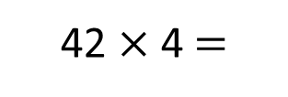
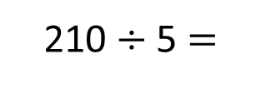
Amir’s sandcastle is 168 cm tall.
Eva
42 cm
210 cm
Amir
42 cm
42 cm
42 cm
42 cm
?
210 $÷$ 5 $=$
42 cm
42 $×$ 4 $=$
168 cm

Slide 4
Amir’s sandcastle is 168 cm tall.
Eva
42 cm
210 cm
Amir
42 cm
42 cm
42 cm
42 cm
What is the difference in height between the two sandcastles?
If Amir’s sandcastle was 210 cm tall, how tall would Eva’s be?

Slide 5


Ron, Dexter and Whitney are collecting shells.
Altogether they collect 54 shells.
Each child collects one more shell
than the child before.
Have a think
How many shells did they each collect?

Slide 6
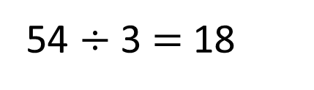
Ron, Dexter and Whitney are collecting shells.
Altogether they collect 54 shells.
Each child collects one more shell
than the child before.
54 $÷$ 3 $=$ 18
17 18 19

Slide 7
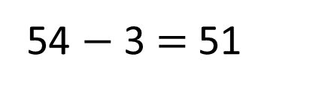
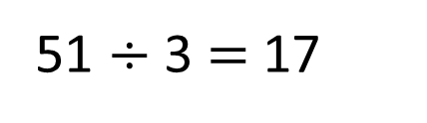
Ron, Dexter and Whitney are collecting shells.
Altogether they collect 54 shells.
Each child collects one more shell
than the child before.
17
17
18
19
17
1
54 $−$ 3 $=$ 51
54
51 $÷$ 3 $=$ 17
17
1
1
How many shells did they each collect?

Slide 8
Each child collects one more shell
than the child before.
How many shells did they each collect?
What if there were 111 shells?

Slide 9

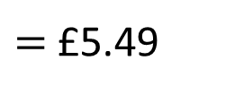
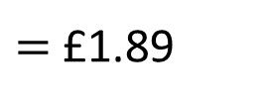
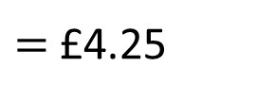
Have a think
$=$ £5.49
Teddy buys a bucket and spade, a hat and a rugby ball for his day trip to the beach.
$=$ £4.25
He pays with a £20 note.
How much change will he receive?
$=$ £1.89

Slide 10


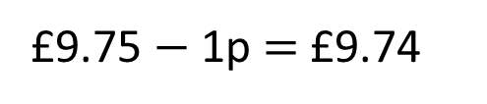
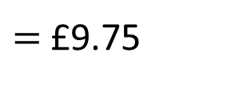
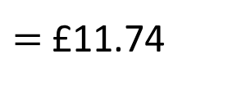



$=$ £5.49
£5.49 $+$ £4.25 $+$ £1.89
£5.50
$+$ £4.25
$=$ £9.75
£9.75 $−$ 1p $=$ £9.74
$=$ £4.25
£9.74 $+$ £1.89
£9.74 $+$
£2.00
$=$ £11.74
$=$ £1.89
£11.74 $−$ 11p $=$ £11.63

Slide 11


The total cost is £11.63
Teddy pays with a £20 note.
How much change will he receive?
£8.37
T | 0 | . | tth | hth
2 | 0 | . | 0 | 0
1 | 1 | . | 6 | 3
T | 0 | . | tth | hth
1 | 9 | . | 9 | 9
1 | 1 | . | 6 | 2
$$−$$
$$−$$
0
8
.
3
7

Slide 12



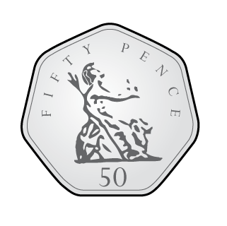
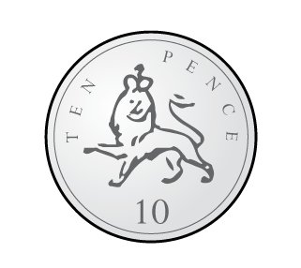

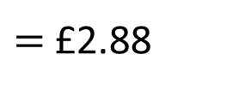
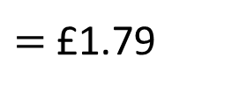
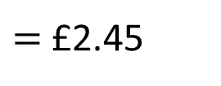
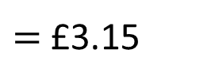
Dora went to a different shop and paid for some items with a £10 note.
$=$ £2.88
Here is the change she received:
$=$ £3.15
$=$ £1.79
$=$ £2.45
Which items did Dora buy?
Have a think

Slide 13
Dora went to a different shop and paid for some items with a £10 note.
$=$ £2.88
Here is the change she received:
$=$ £3.15
$=$ £1.79
£2.61
$=$ £2.45

Slide 14


The items cost Dora £7.39
T | 0 | . | tth | hth
1 | 0 | . | 0 | 0
 | 2 | . | 6 | 1
T | 0 | . | tth | hth
 | 9 | . | 9 | 9
 | 2 | . | 6 | 0
$$−$$
$$−$$
7
.
3
9

Slide 15

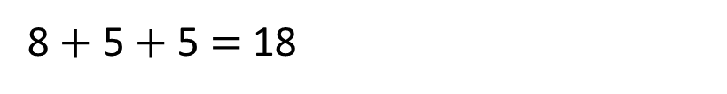
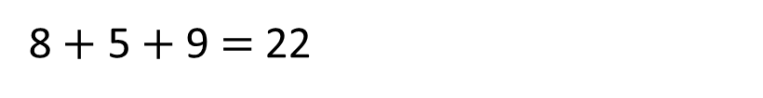
$=$ £2.88
The items cost Dora £7.39
$=$ £3.15
8 $+$ 5 $+$ 9 $=$22
8 $+$ 5 $+$ 5 $=$ 18
$=$ £1.79
5 $+$ 9 $+$ 5 $=$ 19
$=$ £2.45

Slide 16



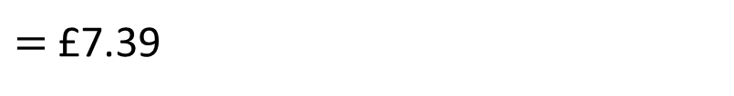


$=$ £2.88
The items cost Dora £7.39
£3.15 $+$ 1.79 $+$ £2.45
$=$ £3.15
5p $+$ 9p $+$ 5p $=$ 19p
10p $+$ 70p $+$ 40p $=$ 120p
$=$ £1.79
£3 $+$ £1 $+$ £2 $=$ £6
£6 $+$ £1.20 $+$ 19p
$=$ £7.39
$=$ £2.45
Dora bought an ice cream, a bucket and a rugby ball.

