Slide 1


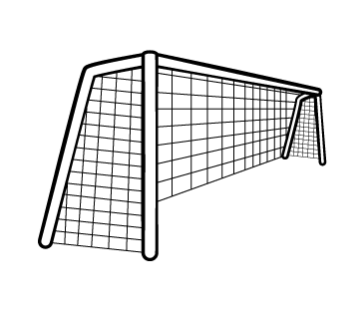












Slide 2

Year 6 are split into 3 teams for Sports day: Team A, B and C.
Team A score twice as many points as Team B.
Team C score 22 more points than Team B.
Altogether the three teams score 226 points.
How many points do Team A score?
Have a think

Slide 3

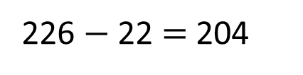
Team A score twice as many points as Team B.
Team C score 22 more points than Team B.
Altogether the three teams score 226 points.
?
51
51
A
226 $−$ 22 $=$ 204
204
51
22
B
226
204 $÷$ 4
51
22
Team A score 102 points.
C
What else can you find out?

Slide 4






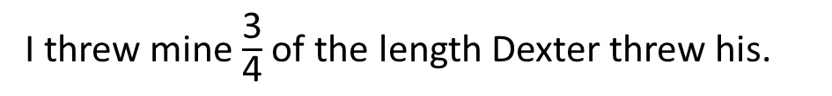
One of the activities is to throw a bean bag as far as you can.
Eva, Mo, Dexter and Dora are all taking part.
Can you work out how far each person threw the bean bag?
I threw mine $\frac{\text{3}}{\text{4}}$ of the length Dexter threw his.
Eva
My bean bag landed 2.6 metres in front of Dexter’s.
Mo
I threw mine the equivalent of 2³ in metres.
Dexter
Mine landed 450 cm in front of Eva’s.
Dora
Have a think

Slide 5
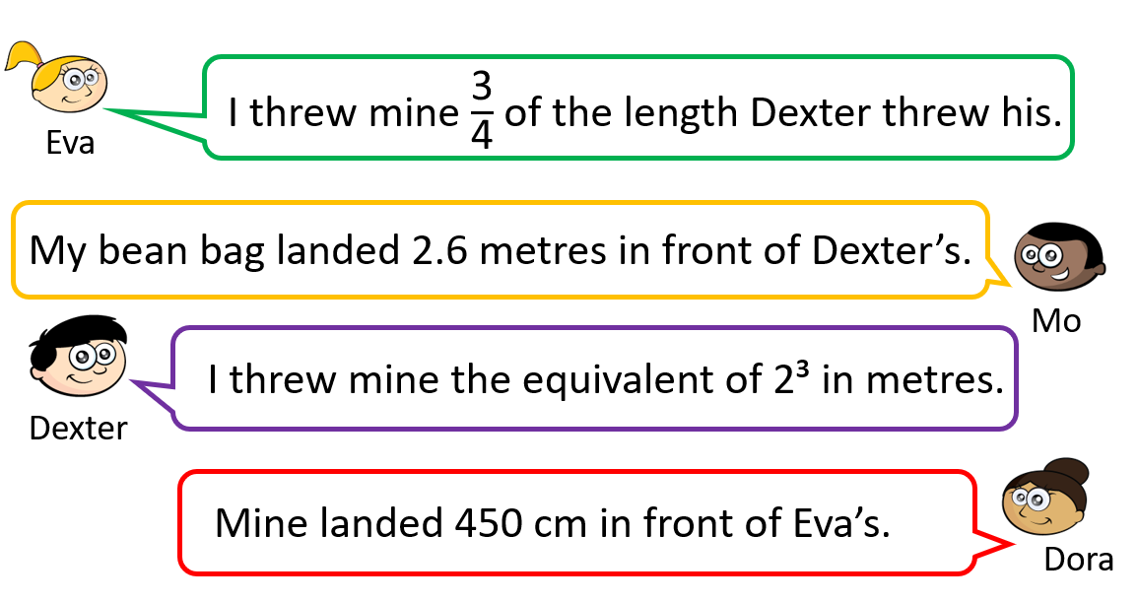

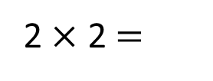
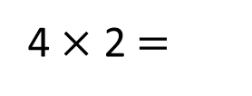
2 $×$ 2 $=$
4
4 $×$ 2 $=$
8
Dexter threw his bean bag 8 metres.

Slide 6
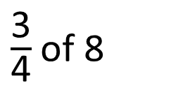
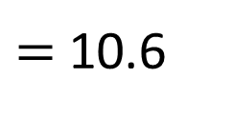
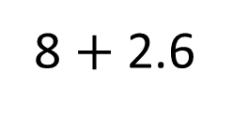

$\frac{\text{3}}{\text{4}}$of 8
$=$ 6
8 $+$ 2.6
$=$ 10.6
Mo threw his bean bag 10.6 metres.
Eva threw her bean bag 6 metres.
Dexter threw his bean bag 8 metres.

Slide 7
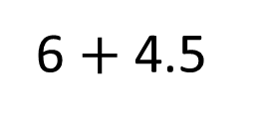
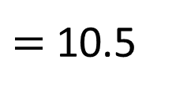
What is the difference between the longest and shortest throw?
6 $+$ 4.5
$=$ 10.5
We have a late entry! Annie’s throw becomes the third furthest throw. What could the distance be?
Dora threw her bean bag 10.5 metres.
Mo threw his bean bag 10.6 metres.
Who threw the furthest? By how many metres?
Eva threw her bean bag 6 metres.
Dexter threw his bean bag 8 metres.

Slide 8
You have to try throw a bean bag into a hoop to score points.

Slide 9
Each child gets 3 bean bags to throw.
Whitney scores 90 points.
Which hoops could the bean bags have landed in?
How many different ways can you find?
Have a think
10 points
20 points
40 points
30 points

Slide 10


Each child gets 3 bean bags to throw.
Whitney scores 90 points.
Which hoops could the bean bags have landed in?
How many different ways can you find?
40 $+$ 30 $+$ 20
40 $+$ 40 $+$ 10
10 points
20 points
40 points
30 points

Slide 11

Each child gets 3 bean bags to throw.
Whitney scores 90 points.
Which hoops could the bean bags have landed in?
How many different ways can you find?
40 $+$ 30 $+$ 20
40 $+$ 40 $+$ 10
30 $+$ 30 $+$ 30
10 points
20 points
40 points
30 points

Slide 12
Each child gets 3 bean bags to throw.
A bean bag cannot land in the same hoop twice.
Find all the possible totals for how many points could be scored.
Have a think
10 points
20 points
40 points
30 points

Slide 13
Each child gets 3 bean bags to throw.
A bean bag cannot land in the same hoop twice.
Find all the possible totals for how many points could be scored.
40 | 30 | 20 | 10 | Total
✓
✓
✓
90
✓
✓
✓
80
✓
✓
✓
70
✓
✓
✓
60
Another hoop is added. If a bean bag lands in it you get 50 points! How many possible totals are there now?

