Slide 1










Slide 2

Month | Temp (℃)
Jan | 14
Feb | 12
Mar | 15
Apr | 17
May | 21
June | 24
July | 27
Aug | 30
Sept | 26
Oct | 22
Nov | 17
Dec | 14
Here is a table showing the average temperatures in Spain all year round.
Draw a line graph to represent this data.
Have a think

Slide 3
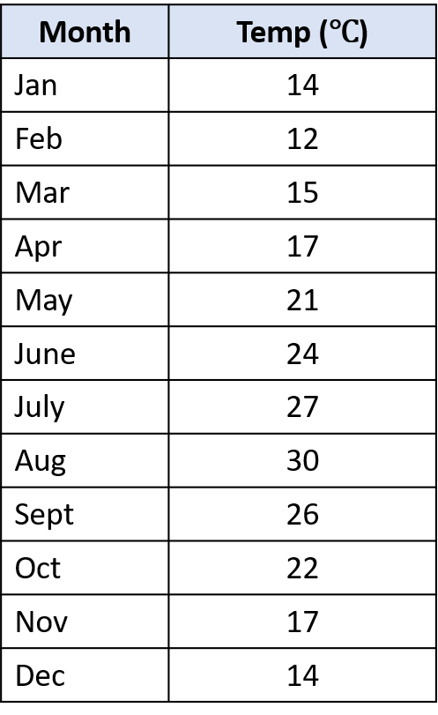

A line graph to show the average temperature (℃) in Spain.
35
30
25
20
Average temperature ($℃)$
15
10
5
0
Jan
Feb
Mar
Apr
May
Jun
Jul
Aug
Sep
Oct
Nov
Dec
Month

Slide 4

Average temperatures in
Spain and Norway
= Spain
= Norway
35
30
True or False?
25
The temperature in Spain is always greater than the temperature in Norway.
20
Average temperature ($℃)$
15
10
5
The temperatures are the same in June.
0
Have a think
Jan
Feb
Mar
Apr
May
Jun
Jul
Aug
Sep
Oct
Nov
Dec
Month

Slide 5
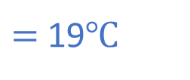
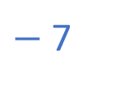
Average temperatures in
Spain and Norway
= Spain
= Norway
35
30
Estimate the difference between Norway’s highest and lowest temperature.
25
20
Average temperature ($℃)$
15
10
26
$−$ 7
$=$ 19$℃$
5
0
Have a think
Jan
Feb
Mar
Apr
May
Jun
Jul
Aug
Sep
Oct
Nov
Dec
Month

Slide 6
Average temperatures in
Spain and Norway
= Spain
= Norway
35
Describe the general trend for temperature in both countries.
30
25
20
Average temperature ($℃)$
Increases gradually from Jan to Aug
15
10
Decreases gradually from Aug to Dec
5
0
Have a think
Jan
Feb
Mar
Apr
May
Jun
Jul
Aug
Sep
Oct
Nov
Dec
Month

Slide 7

30% of Eva’s class are going to France in the Summer holiday.
$\frac{\text{1}}{\text{5}}$ are going to Spain.
The rest are going on holiday in the UK.
15 children are going on holiday in the UK.
How many children are in Eva’s class?
Have a think

Slide 8

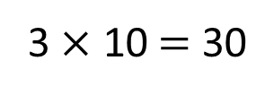
30% of Eva’s class are going to France in the Summer holiday.
$\frac{\text{1}}{\text{5}}$ $=$ 20%
$\frac{\text{1}}{\text{5}}$ are going to Spain.
The rest are going on holiday in the UK.
15 children are going on holiday in the UK.
How many children are in Eva’s class?
30
?
3 $×$ 10 $=$ 30
3
France
Spain
UK
15
There are 30 children in Eva’s class.

Slide 9

Ron is going on holiday with his mum, dad and brother.
They need to be at the airport for 14:15
They are getting a train from Todmorden to Manchester airport.
It’s an 82 minute journey.
Which train should they get?
 | A | B | C
Todmorden | 12:18 | 12:55 | 13:18
Manchester Airport
Have a think

Slide 10




Ron is going on holiday with his mum, dad and brother.
They need to be at the airport for 14:15
They are getting a train from Todmorden to Manchester airport.
It’s an 82 minute journey.
$=$ 1 hour 22 mins
Which train should they get?
 | A | B | C
Todmorden | 12:18 | 12:55 | 13:18
Manchester Airport
13:40
14:17
14:40
$+$ 2 mins
$+$ 20 mins
$+$ 1 hour
12:18
12:20
12:40
13:40

Slide 11
The train makes two stops on the way to the airport.
It takes 23 minutes to get from Todmorden to Rochdale.
It takes 31 minutes to get from Manchester Victoria to Manchester Airport.
Complete the timetable.
Have a think
 | A | B | C
Todmorden | 12:18 | 12:55 | 13:18
Rochdale
Manchester Victoria
Manchester Airport | 13:40 | 14:17 | 14:40

Slide 12


The train makes two stops on the way to the airport.
It takes 23 minutes to get from Todmorden to Rochdale.
It takes 31 minutes to get from Manchester Victoria to Manchester Airport.
Complete the timetable.
 | A | B | C
Todmorden | 12:18 | 12:55 | 13:18
Rochdale
Manchester Victoria
Manchester Airport | 13:40 | 14:17 | 14:40
12:41
13:18
13:41
$+$ 23 mins
13:09
13:46
14:09
$−$ 31 mins

Slide 13

Ron is going on holiday with his mum, dad and brother.
Here are the price of train tickets:
Have a think
Family of 4 return ticket: £40
 | A
Todmorden | 12:18
Rochdale | 12:41
Manchester Victoria | 13:09
Manchester Airport | 13:40
Which is better value for money?
20% off!
Child return ticket: £8
Adult return ticket: £18
$\frac{\text{1}}{\text{3}}$ off!

Slide 14
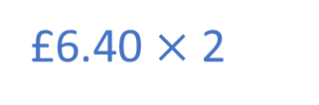
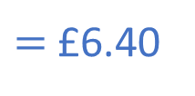
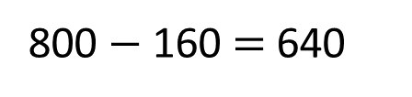

Ron is going on holiday with his mum, dad and brother.
Here are the price of train tickets:
800p
Family of 4 return ticket: £40
80
80
 | A
Todmorden | 12:18
Rochdale | 12:41
Manchester Victoria | 13:09
Manchester Airport | 13:40
Which is better value for money?
?
20% $=$ 160p
20% off!
800 $−$ 160 $=$ 640
Child return ticket: £8
£12.80
$=$ £6.40
Adult return ticket: £18
$\frac{\text{1}}{\text{3}}$ off!
£6.40 $×$ 2

Slide 15

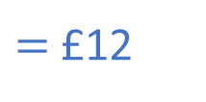

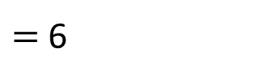
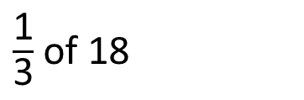
Ron is going on holiday with his mum, dad and brother.
Here are the price of train tickets:
Family of 4 return ticket: £40
Which is better value for money?
$\frac{\text{1}}{\text{3}}$ of 18
$=$ 6
20% off!
Child return ticket: £8
18 $−$ 6 $=$ 12
£12.80
£36.80
$=$ £12
Adult return ticket: £18
$\frac{\text{1}}{\text{3}}$ off!
£12 $×$ 2
£24

