Slide 1

Year 4 Transition Meeting

Slide 2
Welcome!
Aim of presentation: To introduce Year 4 team and outline rules, routines and expectations

Slide 3
Team
Mrs Cox
Mrs Woods
Mrs Castle

Slide 4
Year 4
​
Mrs Woods: Mon/Tues/ Wed, Mrs Cox: Wed, Thurs, Fri. Mrs Castle every day.
Children are encouraged to be independent… come into cloakroom, put away their things and come into class.
If parents need to talk to us, please come at the end of the day or if it is urgent leave a message with the office, it will always get to us.
PE days will be on Thursday with swimming on a Friday
No earrings at all
No pencil cases from home into class or scissors

Slide 5
English - Reading
We will be sending reading records home
Please make a comment to confirm that your child is reading ​
Please can children bring reading records in daily as we stamp them in guided reading
It is important to discuss the text with your child and to hear them read at least 3x a week​
Your child can continue to use our reading scheme or borrow a book from class
Reading Plus: We subscribe to Reading Plus which is a web-based reading programme designed to develop children’s independent reading and comprehension. We had fantastic results last year and as part of their homework children will be required to use it at least twice a week.

Slide 6
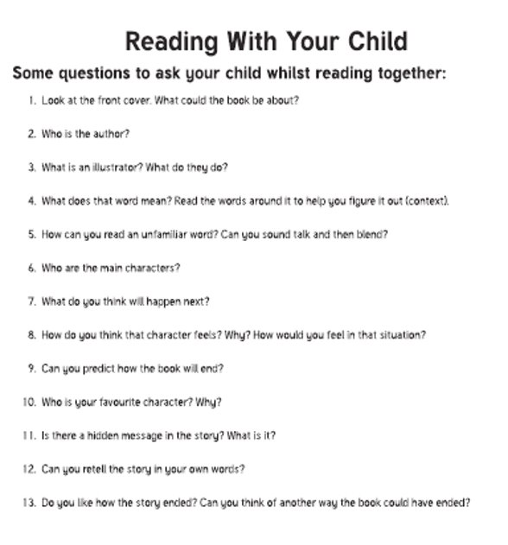
The importance of comprehension

Slide 7
English - Writing
Aim: To improve writing skills through use of a more creative curriculum​
Pupils are asked to write in a range of genres, narrative and non narrative e.g. play script, instructional, report writing, extended story, news report, persuasive
We encourage collaborative work and discussion​
We aim to develop pupils’ punctuation, sentence structure and organisational skills​
Handwriting, spelling and grammar are embedded in the lesson
​

Slide 8
Maths
Aim: To develop pupils’ confidence with number, shape and space, problem solving and data handling skills​
Increase pupils’ range of strategies and speed when calculating mentally​
Mastery approach to teaching maths​
Times Tables – there is a statutory test in the summer term

Slide 9
How can you support at home
English: Reading
Maths – White Rose worksheets on the website
TT Rockstars and times tables
Spellings will be posted on the website
Additional tasks may be set relating to our topics

Slide 10
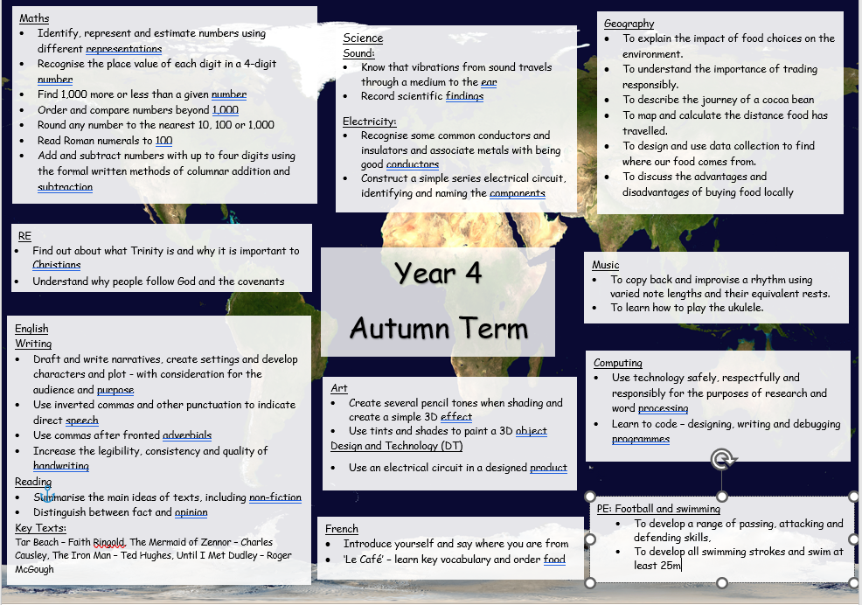
Autumn Term Overview

Slide 11

Timings and Attendance
8.35am – Gate is open
8.40am – Classroom Doors are opened
8.45am – Start of the school day, gate is locked
Any late arrivals will have to go via the office
This term parental engagement and attendance are on our School Improvement Plan, and we want to ensure that parents/carers feel a part of their child’s educational journey and encourage good attendance.
Good attendance also means punctuality, as learning begins at 8.45am.
We are asking that no children are taken out during term time, unless the absence has been authorised (this will only be in exceptional circumstances)
Should your child’s attendance begin to fall, school may contact you to offer support
We are aiming for at least 96% attendance for all children and even at 95% this is still 10 school days missed across the year.
We understand the difficulties we have all faced over the last few years and the impact this has had on all aspects of children’s development and we want to give them all the very best chance of progressing both academically and socially.
Drop off will be from 8.35 and morning work is set. A prompt start is essential. Registration is at 8.45am.

Slide 12
Uniform
Please try to name items to reduce lost property
School colour hair bands​
No jewellery (crosses must be removed for PE)​
Plain gold or silver stud earrings – removed from home on PE days)​
No nail varnish
Black shoes with no markings
PE:
Children to come into school in their PE kits on a Thursday this half term
Please ensure that it is the correct uniform – blue joggers, navy shorts or skort(no cycling shorts),navy blue t-shirt, school hoody or jumper – royal blue.

Slide 13
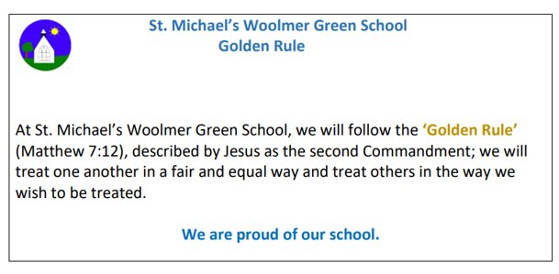
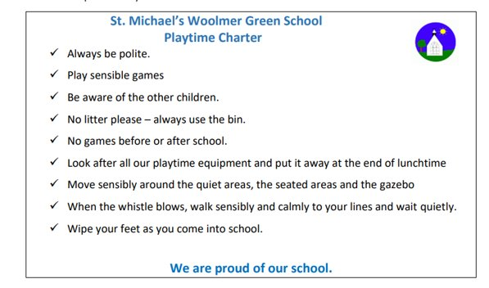
Behaviour
At St. Michael's we expect safe, supportive and polite behaviour at all times​

Slide 14
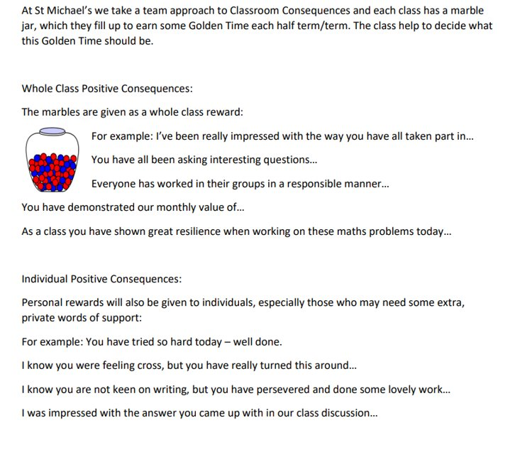
Positive Reinforcement

Slide 15
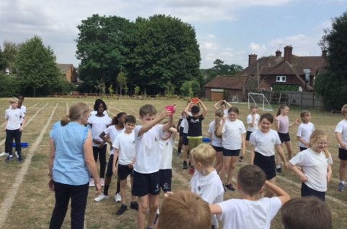
Website
Overview
Spellings
Home Support
We will also post photographs of what we have been up to in school:​

Slide 16

Snack
​
Please can children bring in water bottles and if they would like a snack fruit only please​
​
Our cloakroom is quite limited so only a small bag is needed for their reading record and they can carry their packed lunch and water separately
​
​
​
​

Slide 17

Any Questions?

