Slide 1
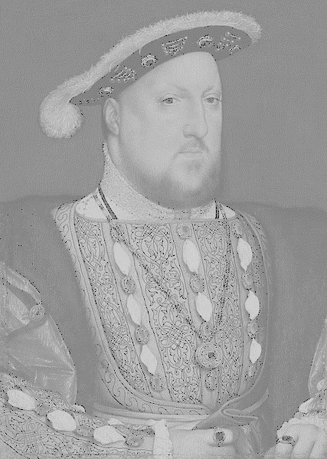
English
Writing
To join my writing and to write legibly and fluently with increasing speed
To describe settings, characters and create atmosphere to engage the reader
To use commas to clarify meaning or to avoid ambiguity
To use a thesaurus to improve vocabulary
To proofread for spelling and punctuation errors
Reading
To predict what might happen from details stated and implied
To read and discuss an increasingly wide range of fiction, poetry, plays, non-fiction and reference books or textbooks
Key texts include: Goth Girl by Chris Riddell, Biography (various),
War Horse by Michael Morpurgo, War Poets (various)
Maths
To read, write, order and compare numbers to at least 1 000 000
To round any number up to 1 000 000
To add and subtract whole numbers with more than 4 digits
To identify multiples and factors
To know prime numbers, prime factors and composite numbers
To multiply numbers up to 4 digits by a one- or two-digit number
To divide numbers up to 4 digits by a one-digit number
To measure and calculate the perimeter of composite rectilinear shapes
To calculate and compare the area of rectangles
Beech – year 5
AUTUMN TERM
History
Tudors
To locate Tudors on a timeline
To learn about Henry VIII
To research responsibilities and duties of Henry VIII
To explore the reasons for Henry’s divorce from Catherine of Aragon
To explore the consequences of Henry’s 6 marriages
To use primary and secondary sources to carry out research
Science
Materials and their Properties
To identify uses of metals, wood and plastic in everyday life
To give reasons, based on evidence from comparative and fair tests, for the particular uses of everyday materials, including metals, wood and plastic
Lifecycles of flowering plants
To describe the functions of some parts of a flower and describe the main functions of parts of a plant involved in reproduction
Religious Education
God
To understand that for Christians knowing God is a journey.
To think about who God could be.
To understand the meaning of omnipotent and omniscient.
To read and understand biblical texts.
Buddhism
To learn about the Buddhist religion and how they worship.
Geography
Topic: Mountains
Locate the key mountain ranges around the world
To describe the key features of mountain ranges
To describe how different mountains are formed
To study the impact of tourism on mountainous areas
To study the climate of mountainous areas
Art
To explore different ways to present self-portraits.
To see how backgrounds have an affect on portraits.
Use mixed media in a range of portrait styles.
Research the artist Chila Kumai Singh Burman
French
As tu un animal? Quel est la date?
To listen attentively to spoken language and show understanding by joining in and responding
To develop accurate pronunciation and intonation so that others understand when they are speaking or reading aloud
Computing
Online Safety
To consider the truth in online content
To learn about the meaning and safety of age restrictions
Coding
To learn about decomposition & abstraction in coding.
To program simulations
To begin to use functions in code
Concept Maps
To use concept maps to record ideas and how they link
PSHE - Friendship
To understand the difference between discrimination and inclusion
To understand what is peer pressure
Music
Exploring and using skills using the Glockenspiel
To listen and appraise rock music
To learn how to play the Ukulele
Design Technology
To analyse items made textiles
To use sewing skills to join and decorate fabrics
To design a patten and cut out from fabric
To improve hand sewing skills
P.E
Fitness
Tag rugby

